Slide 1
Business Analytics, 5e
Chapter 8 – Linear Regression

Slide 2
Chapter Contents
8.1 Simple Linear Regression Model
8.2 Least Squares Method
8.3 Assessing the Fit of the Simple Linear Regression Model
8.4 The Multiple Linear Regression Model
8.5 Inference and Linear Regression
8.6 Categorical Independent Variables
8.7 Modeling Nonlinear Relationships
8.8 Model Fitting
8.9 Big Data and Linear Regression
8.10 Prediction with Linear Regression
Summary

Slide 3
Learning Objectives (1 of 2)
After completing this chapter, you will be able to:
LO 8-1 Construct an estimated simple linear regression model that estimates how a dependent variable is related to an independent variable.
LO 8-2 Construct an estimated multiple linear regression model that estimates how a dependent variable is related to multiple independent variables.
LO 8-3 Compute and interpret the estimated coefficient of determination for a linear regression model.
LO 8-4 Assess whether the conditions necessary for valid inference in a least squares linear regression model are satisfied and test hypotheses about the parameters.
LO 8-5 Test hypotheses about the parameters of a linear regression model and interpret the results of these hypotheses tests.

Slide 4
Learning Objectives (2 of 2)
LO 8-6 Compute and interpret confidence intervals for the parameters of a linear regression model.
LO 8-7 Use dummy variables to incorporate categorical independent variables in a linear regression model and interpret the associated estimated regression parameters.
LO 8-8 Use a quadratic regression model, a piecewise linear regression model, and interaction between independent variables to account for curvilinear relationships between independent variables and the dependent variable in a regression model and interpret the estimated parameters.
LO 8-9 Use an estimated linear regression model to predict the value of the dependent variable given values of the independent variables.

Slide 5
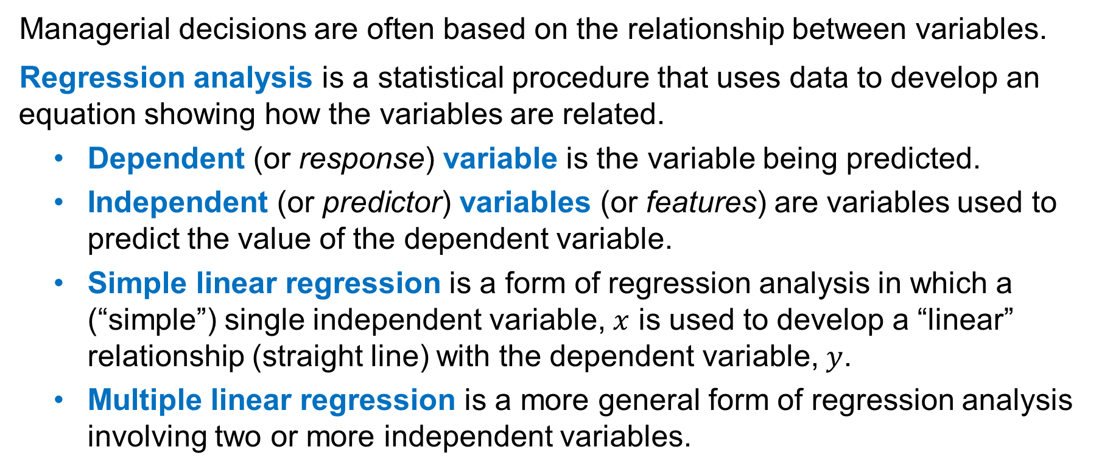
Introduction
Managerial decisions are often based on the relationship between variables.
Regression analysis is a statistical procedure that uses data to develop an equation showing how the variables are related.
Dependent (or response) variable is the variable being predicted.
Independent (or predictor) variables (or features) are variables used to predict the value of the dependent variable.
Simple linear regression is a form of regression analysis in which a (“simple”) single independent variable, $x$ is used to develop a “linear” relationship (straight line) with the dependent variable, $y$.
Multiple linear regression is a more general form of regression analysis involving two or more independent variables.

Slide 6
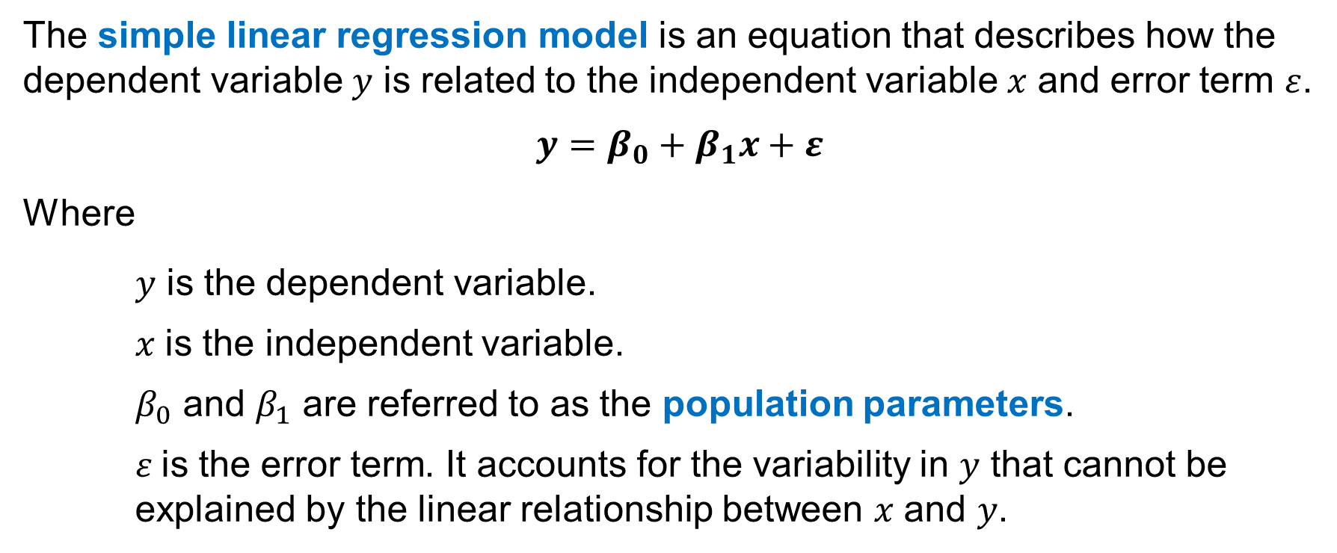
8.1 Simple Linear Regression Model
The simple linear regression model is an equation that describes how the dependent variable 𝑦 is related to the independent variable 𝑥 and error term $ε$.
$$y=β_{0}+β_{1}x+ε$$
Where
𝑦 is the dependent variable.
𝑥 is the independent variable.
$β_{0}$ and $β_{1}$ are referred to as the population parameters.
$ε$is the error term. It accounts for the variability in 𝑦 that cannot be explained by the linear relationship between 𝑥 and 𝑦.

Slide 7
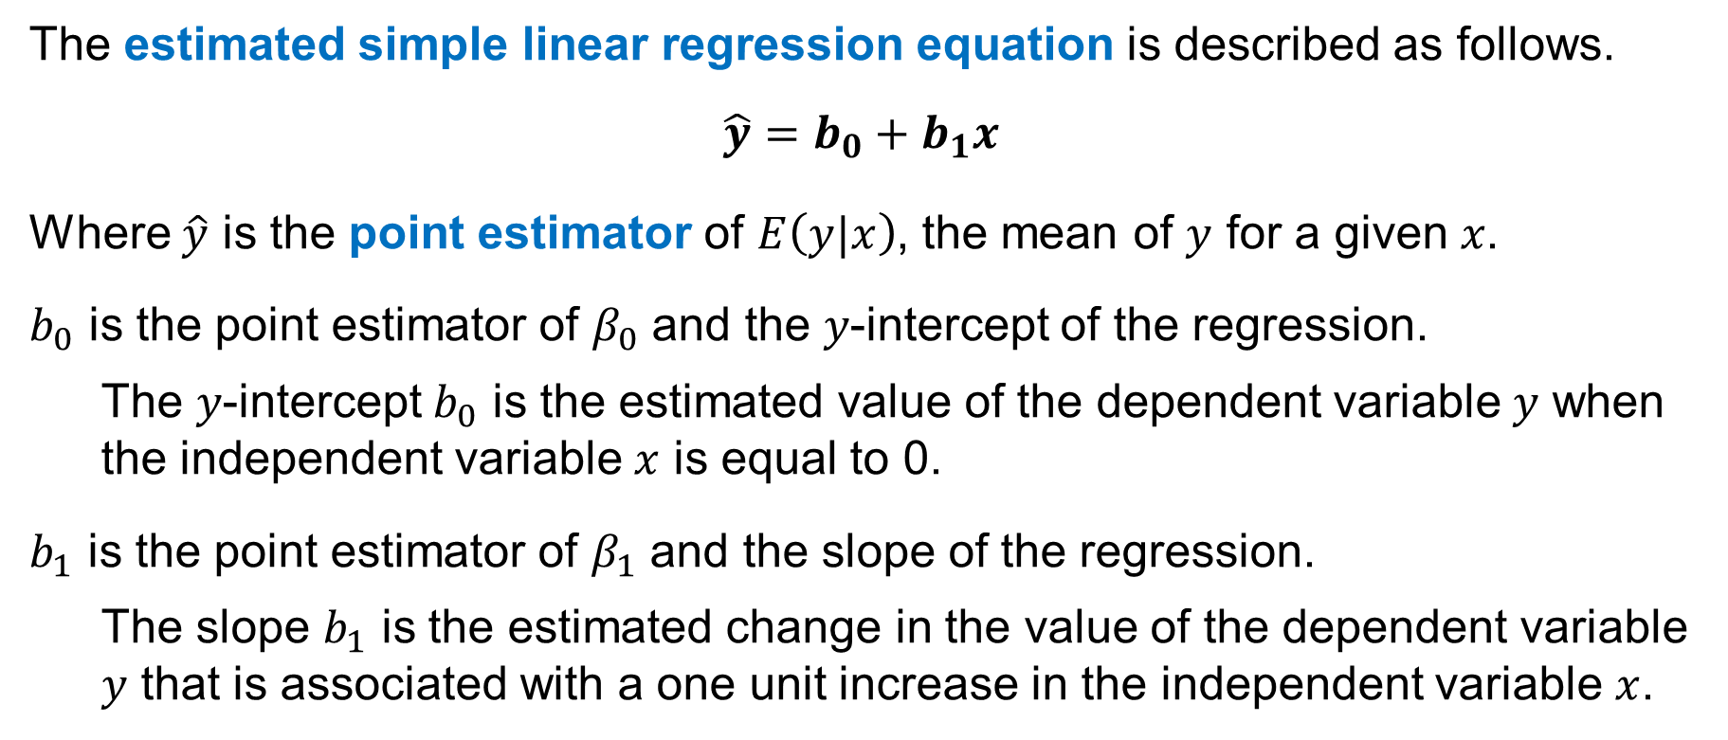
8.1 Estimated Simple Linear Regression Equation
The estimated simple linear regression equation is described as follows.
$\hat{y}=b_{0}+b_{1}x$
Where $\hat{y}$ is the point estimator of $E\left(y|x\right)$, the mean of $y$ for a given 𝑥.
$b_{0}$ is the point estimator of $β_{0}$ and the 𝑦-intercept of the regression.
The 𝑦-intercept $b_{0}$ is the estimated value of the dependent variable 𝑦 when the independent variable $x$ is equal to 0.
$b_{1}$ is the point estimator of $β_{1}$ and the slope of the regression.
The slope $b_{1}$ is the estimated change in the value of the dependent variable 𝑦 that is associated with a one unit increase in the independent variable $x$.

Slide 8
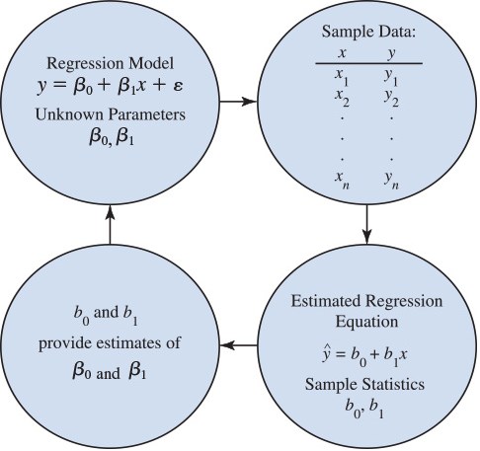
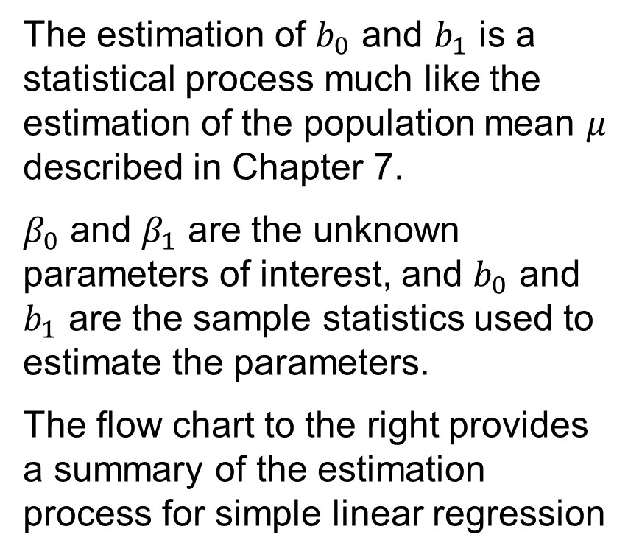
8.1 The Estimation Process in Simple Linear Regression
The estimation of $b_{0}$ and $b_{1}$ is a statistical process much like the estimation of the population mean $μ$ described in Chapter 7.
$β_{0}$ and $β_{1}$ are the unknown parameters of interest, and $b_{0}$ and $b_{1}$ are the sample statistics used to estimate the parameters.
The flow chart to the right provides a summary of the estimation process for simple linear regression

Slide 9
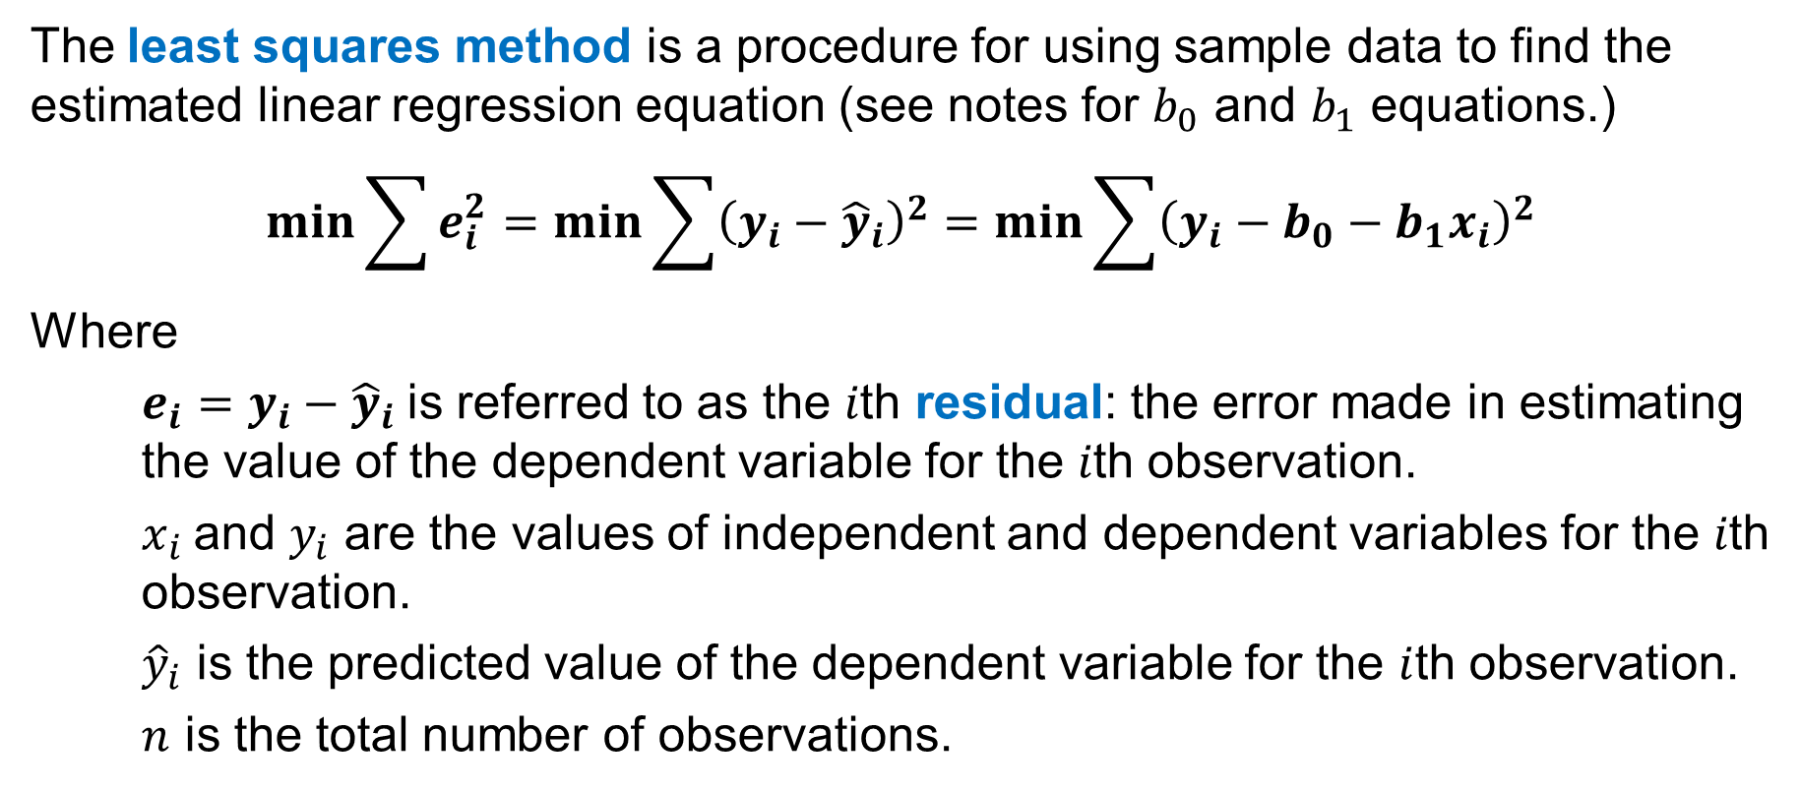
8.2 Least Squares Method
The least squares method is a procedure for using sample data to find the estimated linear regression equation (see notes for $b_{0}$ and $b_{1}$ equations.)
$$\min{\sum{e_{i}^{2}}}=\min{\sum{{\left(y_{i}−{\hat{y}}_{i}\right)}^{2}}}=\min{\sum{{\left(y_{i}−b_{0}−b_{1}x_{i}\right)}^{2}}}$$
Where
$e_{i}=y_{i}−{\hat{y}}_{i}$ is referred to as the 𝑖th residual: the error made in estimating the value of the dependent variable for the 𝑖th observation.
$x_{i}$and $y_{i}$ are the values of independent and dependent variables for the 𝑖th observation.
${\hat{y}}_{i}$ is the predicted value of the dependent variable for the $i$th observation.
$n$ is the total number of observations.
Notes:
Differential calculus can be used to show that the values of $b_{0}$ and $b_{1}$ that minimize the least squares criterion are given by
$$b_{1}=\frac{\sum{\left(x_{i}−\overline{x}\right)\left(y_{i}−\overline{y}\right)}}{\sum{{\left(x_{i}−\overline{x}\right)}^{2}}}$$
$$b_{0}=\overline{y}−b_{1}\overline{x}$$

Slide 10
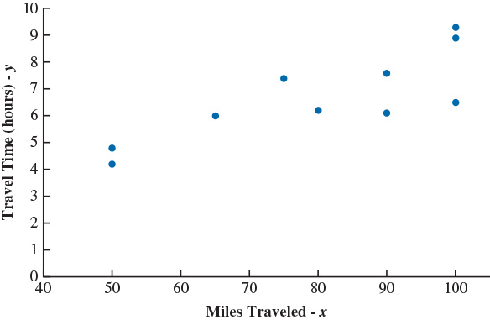
8.2 The Butler Trucking Company Example
We use a sample of 10 randomly selected driving assignments made by the Butler Trucking Company to build a scatter chart depicting the relationship between the travel time (in hours) and the miles traveled.
DATAfile: butler
Because the scatter diagram shows a positive linear relationship, we choose the simple linear regression model to represent the relationship between travel time (𝑦) and miles traveled (𝑥.)

Slide 11
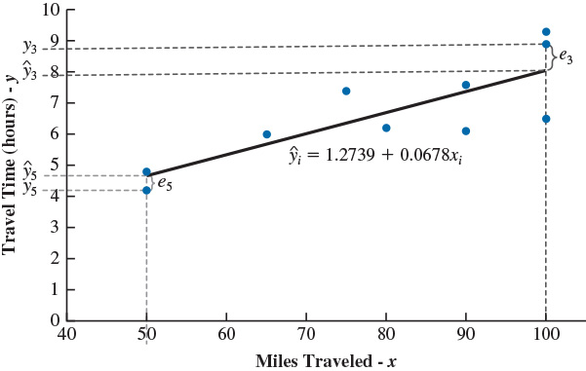
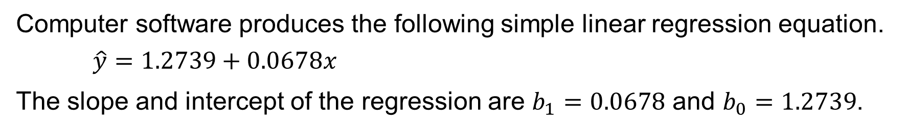
8.2 Regression Equation for Butler Trucking Co.
Computer software produces the following simple linear regression equation.
$$\hat{y}=1.2739+0.0678x$$
The slope and intercept of the regression are $b_{1}=0.0678$ and $b_{0}=1.2739$.
Thus, we estimate that if the length of a driving assignment were 1 mile longer, the mean travel time would be 0.0678 hours or ~4 minutes longer.
Also, if the length of a driving assignment were 0 miles, the mean travel time would be 1.2739 hours or ~76 minutes. See notes for Excel.
Notes:
The following steps describe how to compute the estimated linear regression equation using the butler data:
Step 1. Right-click on any data point in the scatter chart and select Add Trendline
Step 2. When the Format Trendline task pane appears:
Select Linear in the Trendline Options area
Select Display Equation on chart in the Trendline Options area

Slide 12
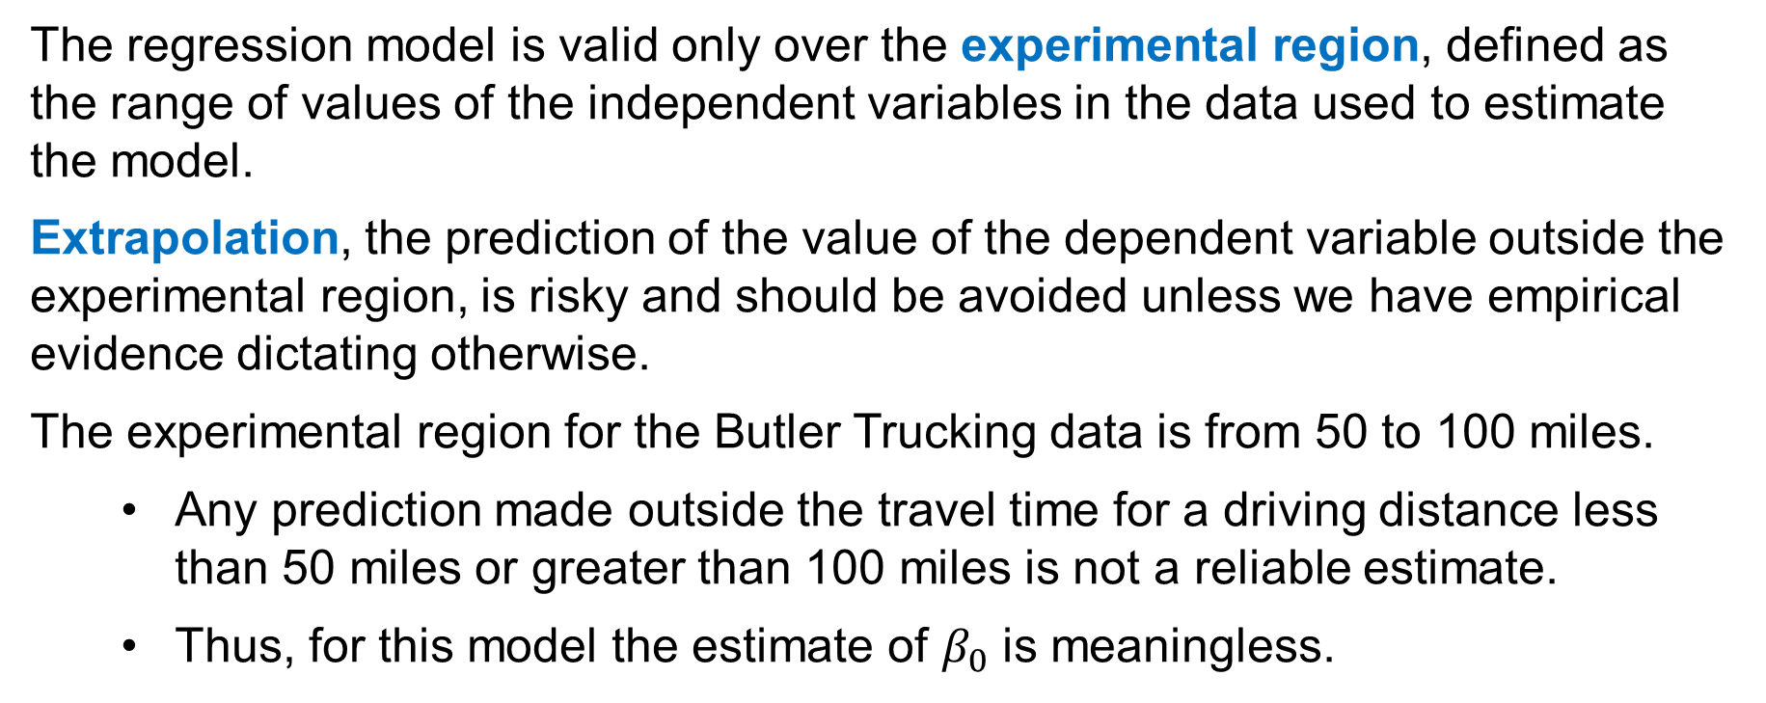
8.2 Experimental Region and Extrapolation
The regression model is valid only over the experimental region, defined as the range of values of the independent variables in the data used to estimate the model.
Extrapolation, the prediction of the value of the dependent variable outside the experimental region, is risky and should be avoided unless we have empirical evidence dictating otherwise.
The experimental region for the Butler Trucking data is from 50 to 100 miles.
Any prediction made outside the travel time for a driving distance less than 50 miles or greater than 100 miles is not a reliable estimate.
Thus, for this model the estimate of $β_{0}$ is meaningless.

Slide 13
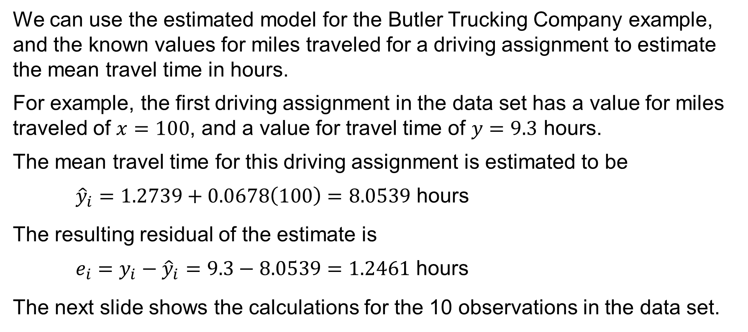
8.2 Estimating Travel Time for the Butler Trucking Co.
We can use the estimated model for the Butler Trucking Company example, and the known values for miles traveled for a driving assignment to estimate the mean travel time in hours.
For example, the first driving assignment in the data set has a value for miles traveled of $x=100$, and a value for travel time of $y=9.3$ hours.
The mean travel time for this driving assignment is estimated to be
${\hat{y}}_{i}=1.2739+0.0678\left(100\right)=8.0539$ hours
The resulting residual of the estimate is
$e_{i}=y_{i}−{\hat{y}}_{i}=9.3−8.0539=1.2461$ hours
The next slide shows the calculations for the 10 observations in the data set.

Slide 14
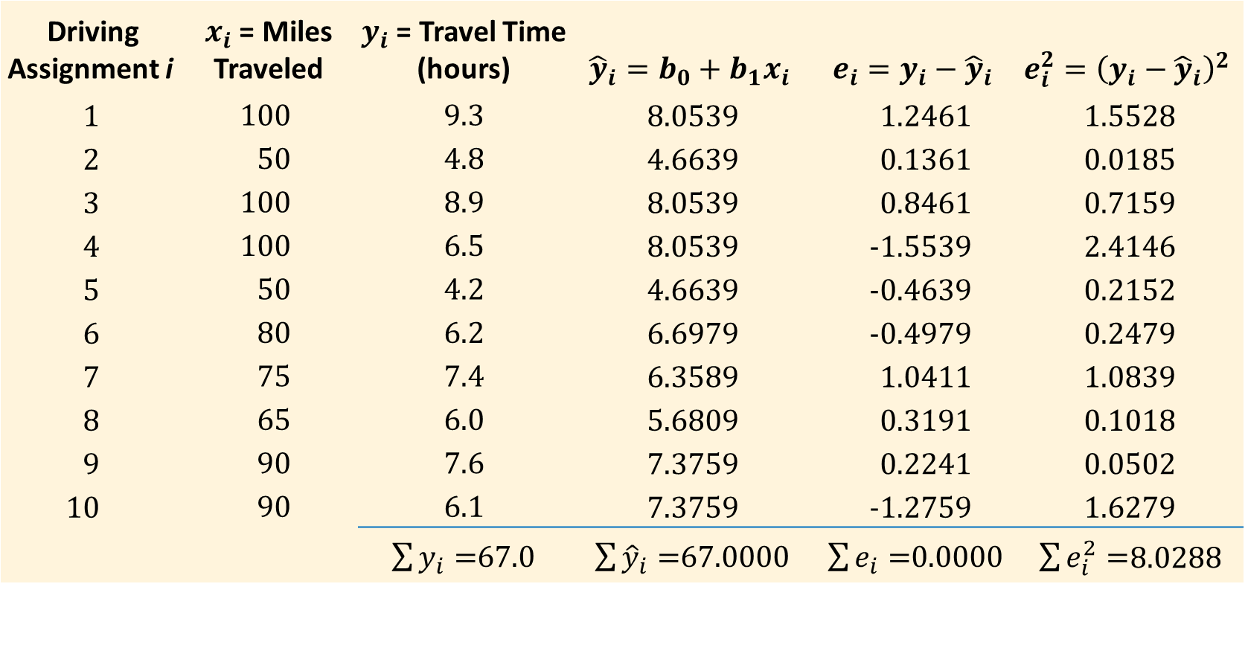
8.2 Predicted Travel Time and Residuals
Driving Assignment i | $x_{i}$ = Miles Traveled | $y_{i}$ = Travel Time (hours) | $${\hat{y}}_{i}=b_{0}+b_{1}x_{i}$$ | $$e_{i}=y_{i}−{\hat{y}}_{i}$$ | $$e_{i}^{2}={\left(y_{i}−{\hat{y}}_{i}\right)}^{2}$$
1 | 100 | 9.3 | 8.0539 | 1.2461 | 1.5528
2 | 50 | 4.8 | 4.6639 | 0.1361 | 0.0185
3 | 100 | 8.9 | 8.0539 | 0.8461 | 0.7159
4 | 100 | 6.5 | 8.0539 | -1.5539 | 2.4146
5 | 50 | 4.2 | 4.6639 | -0.4639 | 0.2152
6 | 80 | 6.2 | 6.6979 | -0.4979 | 0.2479
7 | 75 | 7.4 | 6.3589 | 1.0411 | 1.0839
8 | 65 | 6.0 | 5.6809 | 0.3191 | 0.1018
9 | 90 | 7.6 | 7.3759 | 0.2241 | 0.0502
10 | 90 | 6.1 | 7.3759 | -1.2759 | 1.6279
 |  | $\sum{y_{i}=}$67.0 | $\sum{{\hat{y}}_{i}=}$67.0000 | $\sum{e_{i}=}$0.0000 | $\sum{e_{i}^{2}=}$8.0288

Slide 15
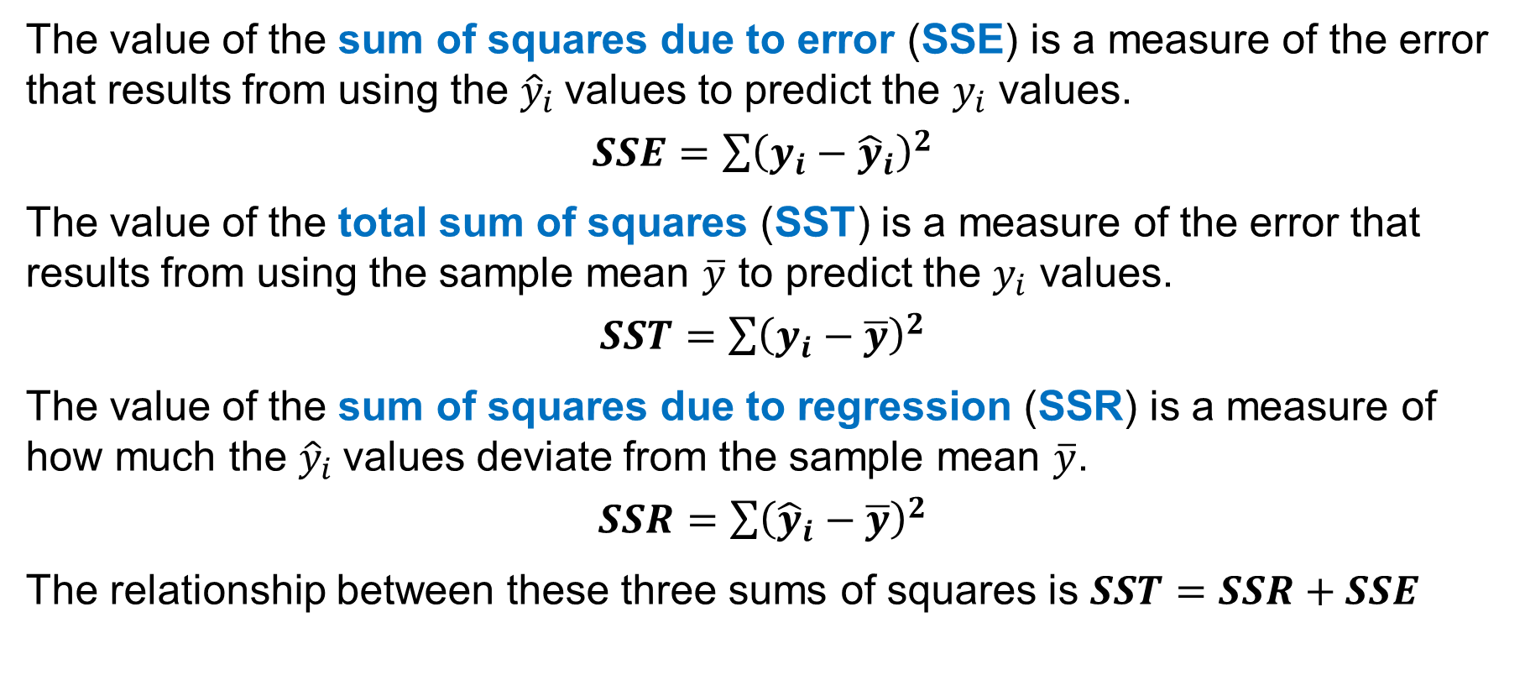
8.3 The Sums of Squares
The value of the sum of squares due to error (SSE) is a measure of the error that results from using the ${\hat{y}}_{i}$values to predict the $y_{i}$ values.
$SSE=\sum{{\left(y_{i}−{\hat{y}}_{i}\right)}^{2}}$
The value of the total sum of squares (SST) is a measure of the error that results from using the sample mean $\overline{y}$ to predict the $y_{i}$ values.
$SST=\sum{{\left(y_{i}−\overline{y}\right)}^{2}}$
The value of the sum of squares due to regression (SSR) is a measure of how much the ${\hat{y}}_{i}$values deviate from the sample mean $\overline{y}$.
$SSR=\sum{{\left({\hat{y}}_{i}−\overline{y}\right)}^{2}}$
The relationship between these three sums of squares is $SST=SSR+SSE$

Slide 16
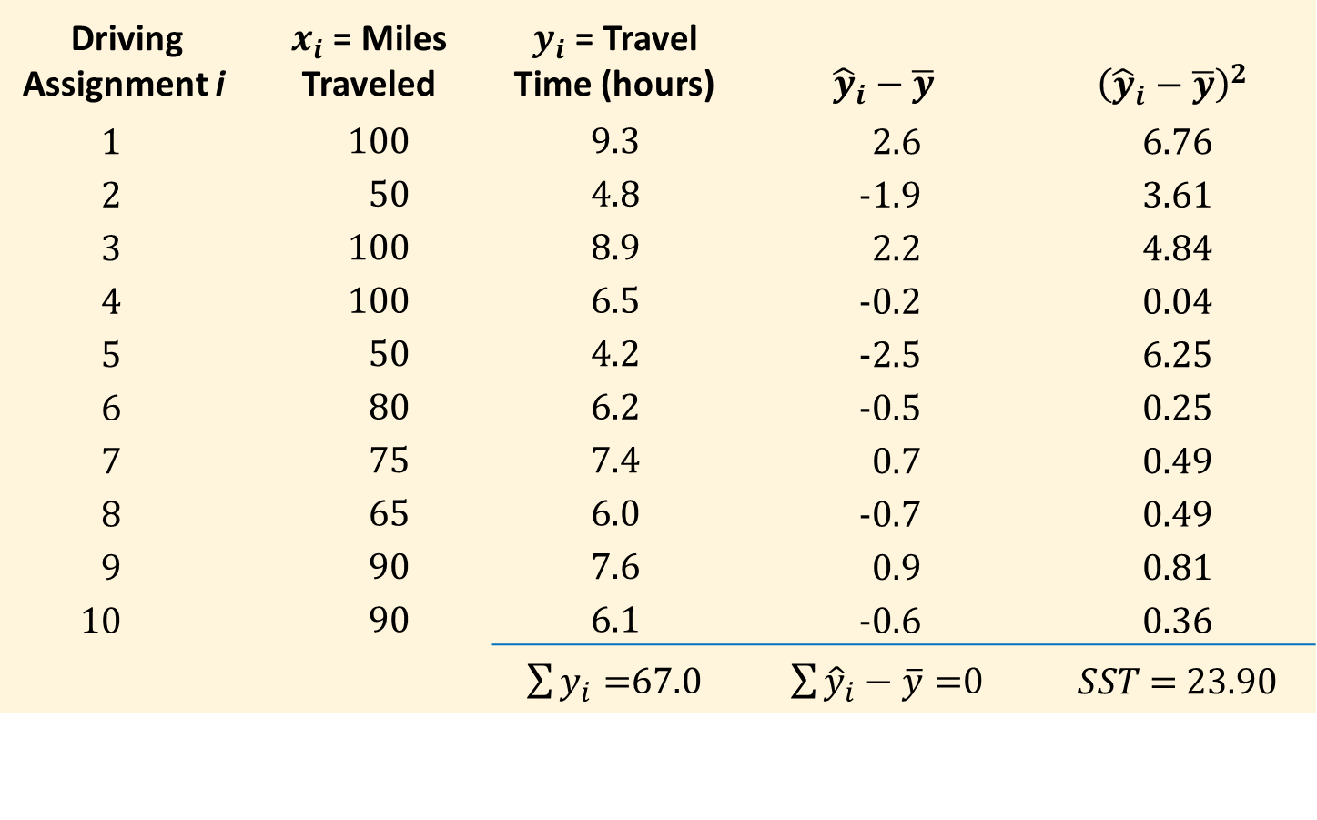
8.3 Total Sum of Squares for the Butler Trucking Co.
Driving Assignment i | $x_{i}$ = Miles Traveled | $y_{i}$ = Travel Time (hours) | $${\hat{y}}_{i}−\overline{y}$$ | $${\left({\hat{y}}_{i}−\overline{y}\right)}^{2}$$
1 | 100 | 9.3 | 2.6 | 6.76
2 | 50 | 4.8 | -1.9 | 3.61
3 | 100 | 8.9 | 2.2 | 4.84
4 | 100 | 6.5 | -0.2 | 0.04
5 | 50 | 4.2 | -2.5 | 6.25
6 | 80 | 6.2 | -0.5 | 0.25
7 | 75 | 7.4 | 0.7 | 0.49
8 | 65 | 6.0 | -0.7 | 0.49
9 | 90 | 7.6 | 0.9 | 0.81
10 | 90 | 6.1 | -0.6 | 0.36
 |  | $\sum{y_{i}=}$67.0 | $\sum{{\hat{y}}_{i}−\overline{y}=}$0 | $SST$ = 23.90

Slide 17
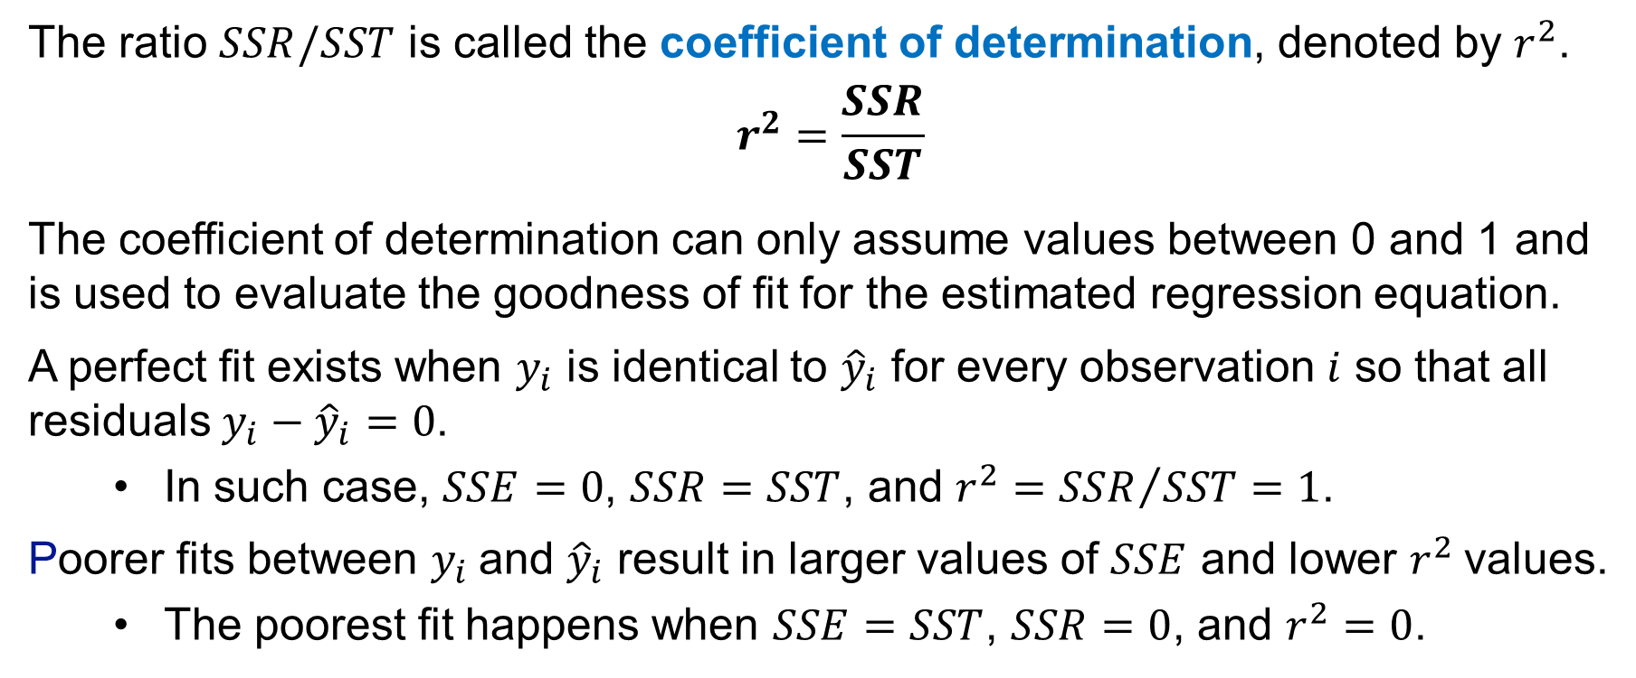
8.3 Coefficient of Determination
The ratio $SSR/SST$ is called the coefficient of determination, denoted by $r^{2}$.
$$r^{2}=\frac{SSR}{SST}$$
The coefficient of determination can only assume values between 0 and 1 and is used to evaluate the goodness of fit for the estimated regression equation.
A perfect fit exists when $y_{i}$ is identical to ${\hat{y}}_{i}$ for every observation $i$ so that all residuals $y_{i}−{\hat{y}}_{i}=0$.
In such case, $SSE=0$, $SSR=SST$, and ${r^{2}=SSR}/{SST}=1$.
Poorer fits between $y_{i}$and ${\hat{y}}_{i}$ result in larger values of $SSE$ and lower $r^{2}$values.
The poorest fit happens when $SSE=SST$, $SSR=0$, and $r^{2}=0$.

Slide 18
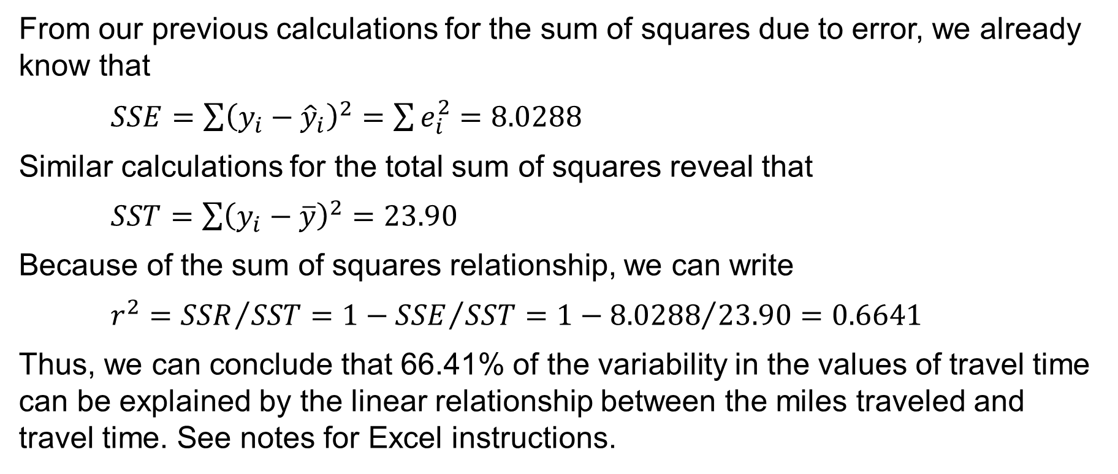
8.3 Goodness of Fit for the Butler Trucking Co.
From our previous calculations for the sum of squares due to error, we already know that
$SSE=\sum{{\left(y_{i}−{\hat{y}}_{i}\right)}^{2}}=\sum{e_{i}^{2}}=8.0288$
Similar calculations for the total sum of squares reveal that
$SST=\sum{{\left(y_{i}−\overline{y}\right)}^{2}}=23.90$
Because of the sum of squares relationship, we can write
${r^{2}=SSR}/{SST}=1−{SSE}/{SST}=1−{8.0288}/{23.90}=0.6641$
Thus, we can conclude that 66.41% of the variability in the values of travel time can be explained by the linear relationship between the miles traveled and travel time. See notes for Excel instructions.
Notes:
The following steps describe how to add the coefficient determination to the estimated linear regression equation obtained on the butler data.
Step 1. Right-click on any data point in the scatter chart and select Add Trendline... Step 2. When the Format Trendline task pane appears: Select Display R-squared value on chart in the Trendline Options area

Slide 19
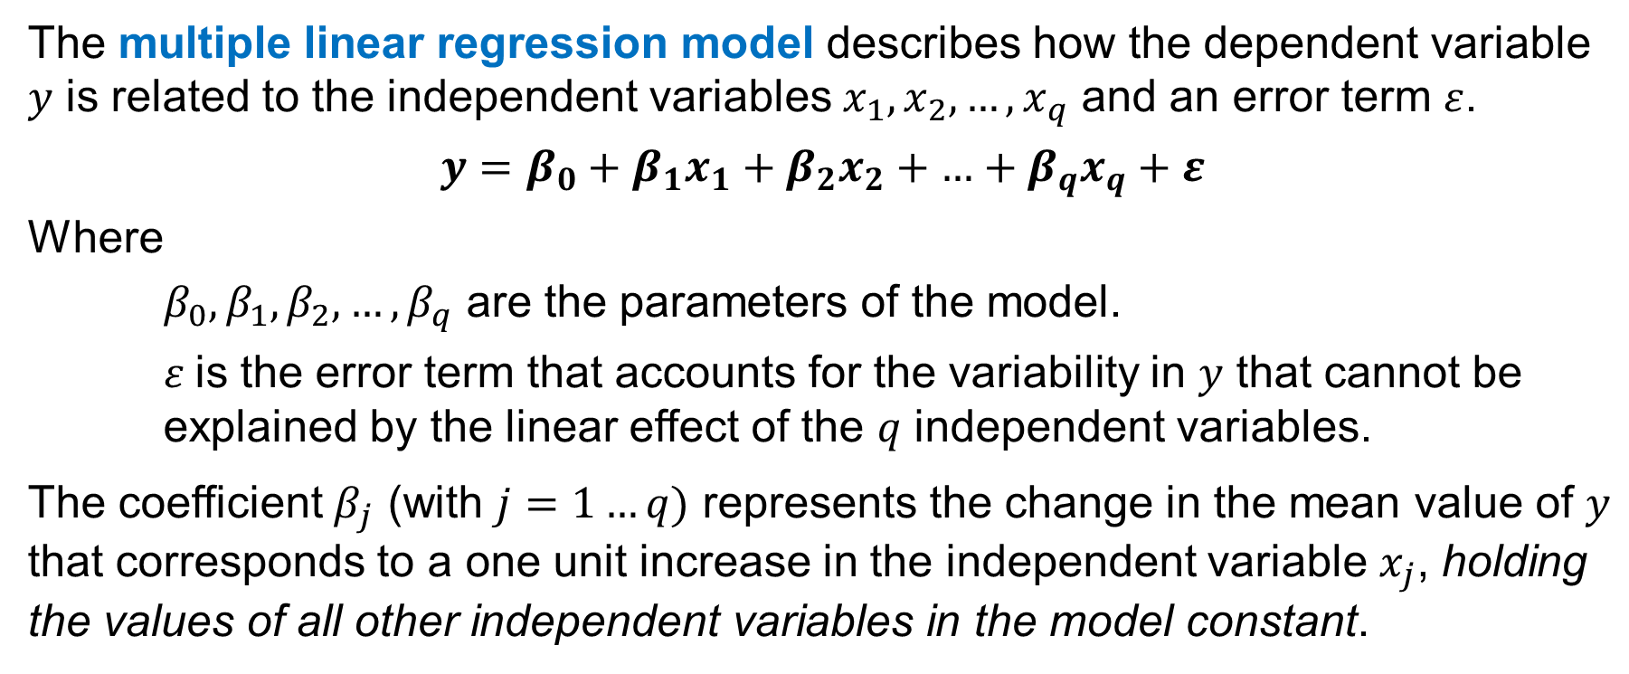
8.4 Multiple Linear Regression Model
The multiple linear regression model describes how the dependent variable 𝑦 is related to the independent variables $x_{1}, x_{2}, …, x_{q}$ and an error term $ε$.
$$y=β_{0}+β_{1}x_{1}+β_{2}x_{2}+\text{…}+β_{q}x_{q}+ε$$
Where
$β_{0},β_{1},β_{2},…,β_{q}$ are the parameters of the model.
$ε$is the error term that accounts for the variability in 𝑦 that cannot be explained by the linear effect of the $q$ independent variables.
The coefficient $β_{j}$ (with $j=1…q)$ represents the change in the mean value of $y$ that corresponds to a one unit increase in the independent variable $x_{j}$, holding the values of all other independent variables in the model constant.

Slide 20
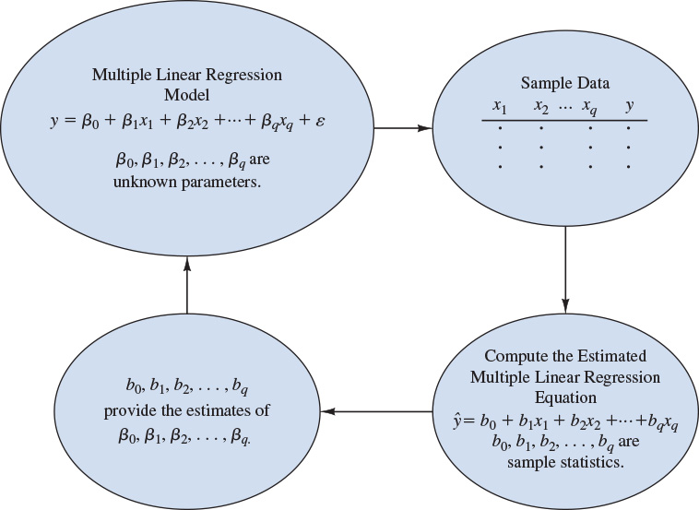
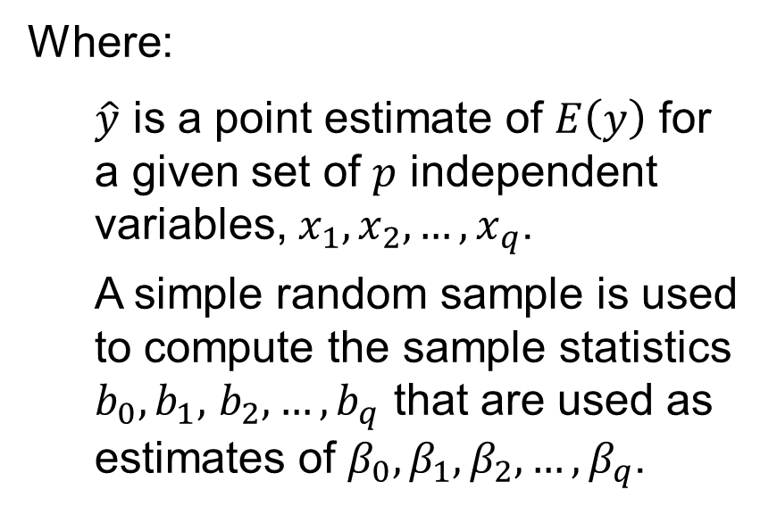
8.4 The Estimation Process in Multiple Regression
The estimated multiple linear regression equation is
$$\hat{y}=b_{0}+b_{1}x_{1}+b_{2}x_{2}+\text{…}+b_{q}x_{q}$$
Where:
$\hat{y}$ is a point estimate of $E\left(y\right)$ for a given set of $p$ independent variables, $x_{1},x_{2},…,x_{q}$.
A simple random sample is used to compute the sample statistics $b_{0},b_{1},$ $b_{2},…,b_{q}$ that are used as estimates of $β_{0},β_{1},β_{2},…,β_{q}$.

Slide 21
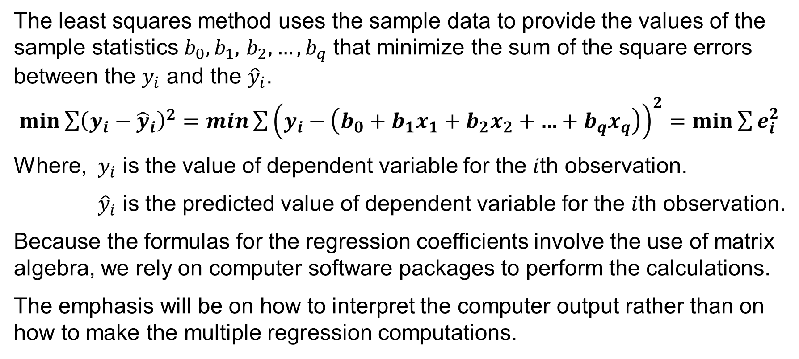
8.4 Least Squares Method and Multiple Regression
The least squares method uses the sample data to provide the values of the sample statistics $b_{0},b_{1},$ $b_{2},…,b_{q}$ that minimize the sum of the square errors between the $y_{i}$ and the ${\hat{y}}_{i}$.
$\min{\sum{{\left(y_{i}−{\hat{y}}_{i}\right)}^{2}}}=\min{\sum{{\left(y_{i}−\left(b_{0}+b_{1}x_{1}+b_{2}x_{2}+\text{…}+b_{q}x_{q}\right)\right)}^{2}}}=\min{\sum{e_{i}^{2}}}$
Where, $y_{i}$ is the value of dependent variable for the 𝑖th observation.
${\hat{y}}_{i}$ is the predicted value of dependent variable for the 𝑖th observation.
Because the formulas for the regression coefficients involve the use of matrix algebra, we rely on computer software packages to perform the calculations.
The emphasis will be on how to interpret the computer output rather than on how to make the multiple regression computations.

Slide 22
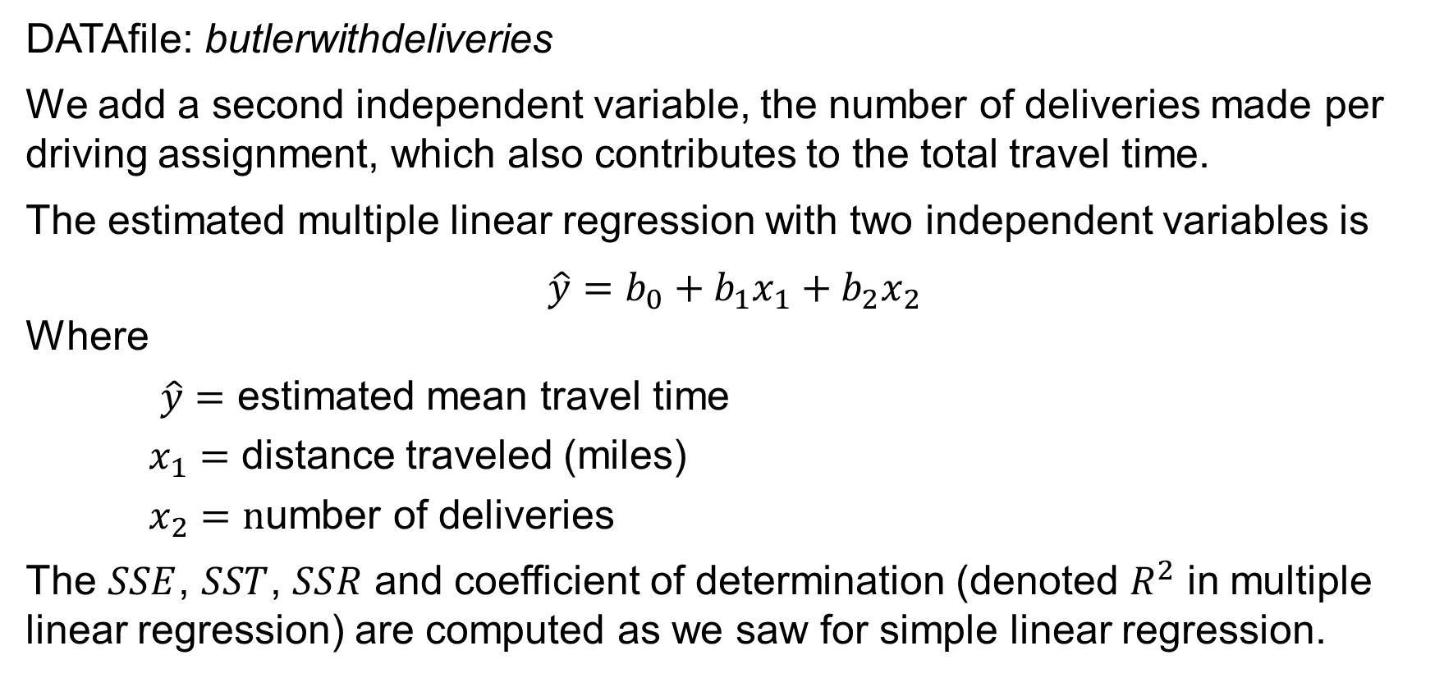
8.4 Multiple Regression with Two Independent Variables
DATAfile: butlerwithdeliveries
We add a second independent variable, the number of deliveries made per driving assignment, which also contributes to the total travel time.
The estimated multiple linear regression with two independent variables is
$\hat{y}=b_{0}+b_{1}x_{1}+b_{2}x_{2}$
Where
$\hat{y}=$ estimated mean travel time
$x_{1}=$ distance traveled (miles)
$x_{2}=n$umber of deliveries
The $SSE$, $SST$, $SSR$ and coefficient of determination (denoted $R^{2}$ in multiple linear regression) are computed as we saw for simple linear regression.

Slide 23
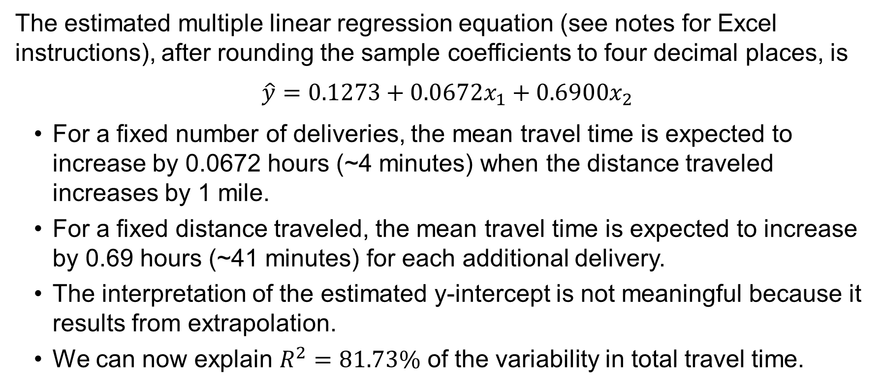
8.4 Butler Trucking Co. and Multiple Regression
The estimated multiple linear regression equation (see notes for Excel instructions), after rounding the sample coefficients to four decimal places, is
$\hat{y}=0.1273+0.0672x_{1}+0.6900x_{2}$
For a fixed number of deliveries, the mean travel time is expected to increase by 0.0672 hours (~4 minutes) when the distance traveled increases by 1 mile.
For a fixed distance traveled, the mean travel time is expected to increase by 0.69 hours (~41 minutes) for each additional delivery.
The interpretation of the estimated y-intercept is not meaningful because it results from extrapolation.
We can now explain $R^{2}=81.73\%$ of the variability in total travel time.
Notes:
The following steps describe how to use Excel’s Regression tool to compute the estimated multiple linear regression equation using the DATAfile butlerwithdeliveries.
Step 1. Click the Data tab in the Ribbon Step 2. Click Data Analysis in the Analysis group Step 3. Select Regression from the list of Analysis Tools in the Data Analysis tools box and click OK Step 4. When the Regression dialog box appears: Enter D1:D301 in the Input Y Range: box Enter B1:C301 in the Input X Range: box Select Labels Select Confidence Level: Enter 99 in the Confidence Level: box Select New Worksheet Ply: Click OK

Slide 24
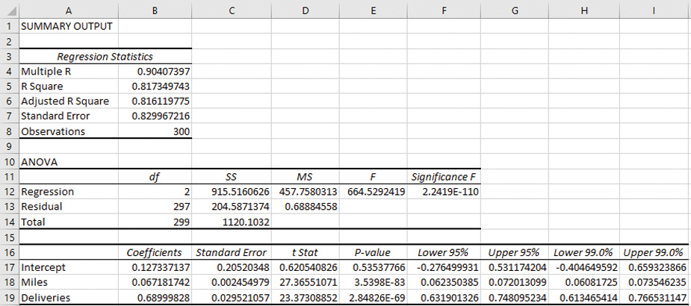
8.4 Butler Trucking Co. Excel Regression Output

Slide 25
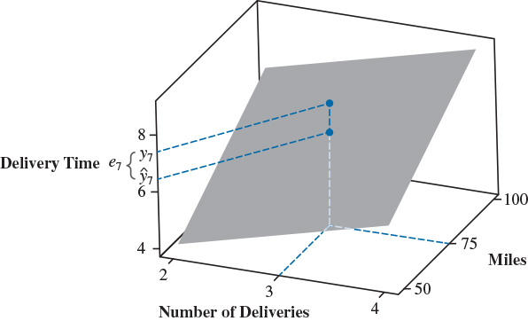
8.4 Graph of the Multiple Linear Regression Equation
With two independent variables $x_{1}$ and $x_{2}$, we now generate a predicted value of $y$ for every combination of values of $x_{1}$ and $x_{2}$.
Instead of a regression line, we now create a 3-D regression plane.
The graph of the estimated regression plane shows the seventh driving assignment for the Butler Trucking Company example.
*See notes for details on the interpretation of the graph.
Notes:
*As either the number of miles traveled ($x_{1}$) or the number of deliveries ($x_{2}$) increases, the plane slopes upward to larger values of total travel time ($\hat{y}$).
The residual for a driving assignment when $x_{1}$ = 75 and $x_{2}$ = 3 is the difference between the observed y value and the corresponding estimated mean value of $y$.
The observed value lies above the regression plane, indicating that the regression model underestimates the expected driving time for the seventh driving assignment.

Slide 26
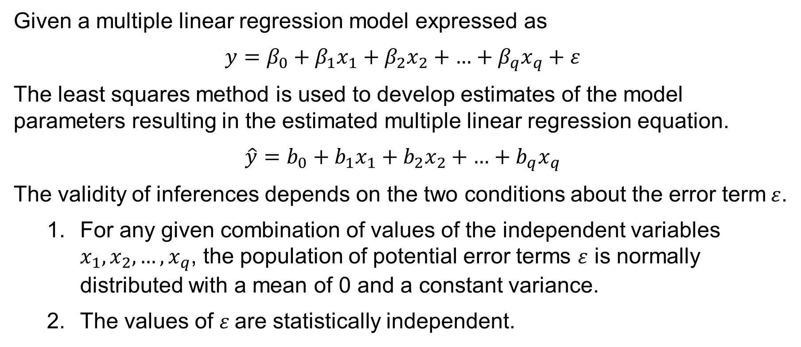
8.5 Conditions for Valid Inference in Regression
Given a multiple linear regression model expressed as
$y=β_{0}+β_{1}x_{1}+β_{2}x_{2}+\text{…}+β_{q}x_{q}+ε$
The least squares method is used to develop estimates of the model parameters resulting in the estimated multiple linear regression equation.
$\hat{y}=b_{0}+b_{1}x_{1}+b_{2}x_{2}+\text{…}+b_{q}x_{q}$
The validity of inferences depends on the two conditions about the error term$ε$.
For any given combination of values of the independent variables $x_{1},x_{2},…,x_{q}$, the population of potential error terms $ε$ is normally distributed with a mean of 0 and a constant variance.
The values of $ε$are statistically independent.

Slide 27
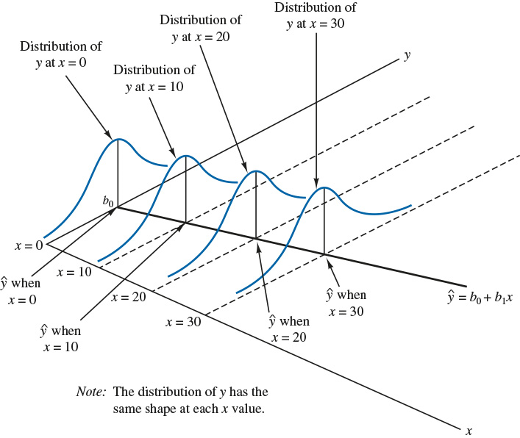
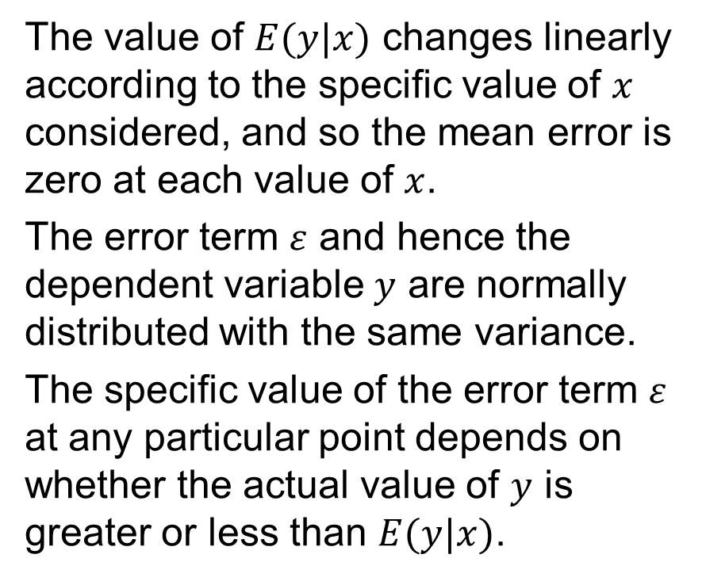
8.5 Illustration of the Conditions for Valid Inference
The value of $E(y|x)$ changes linearly according to the specific value of $x$ considered, and so the mean error is zero at each value of $x$.
The error term $ε$ and hence the dependent variable $y$ are normally distributed with the same variance.
The specific value of the error term $ε$ at any particular point depends on whether the actual value of $y$ is greater or less than $E(y|x)$.

Slide 28
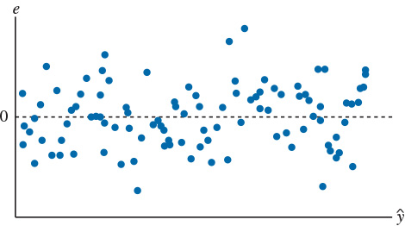
8.5 Scatter Chart of the Residuals
A simple scatter chart of the residuals is an extremely effective method for assessing whether the error term conditions are violated.
The example to the right displays a random error pattern for a scatter chart of residuals versus the predicted values of the dependent variable.
For proper inference, the scatter chart must exhibit a random pattern with
residuals centered around zero,
a constant spread of the residuals throughout, and
residuals symmetrically distributed with the values near zero occurring more frequently than those outside.

Slide 29
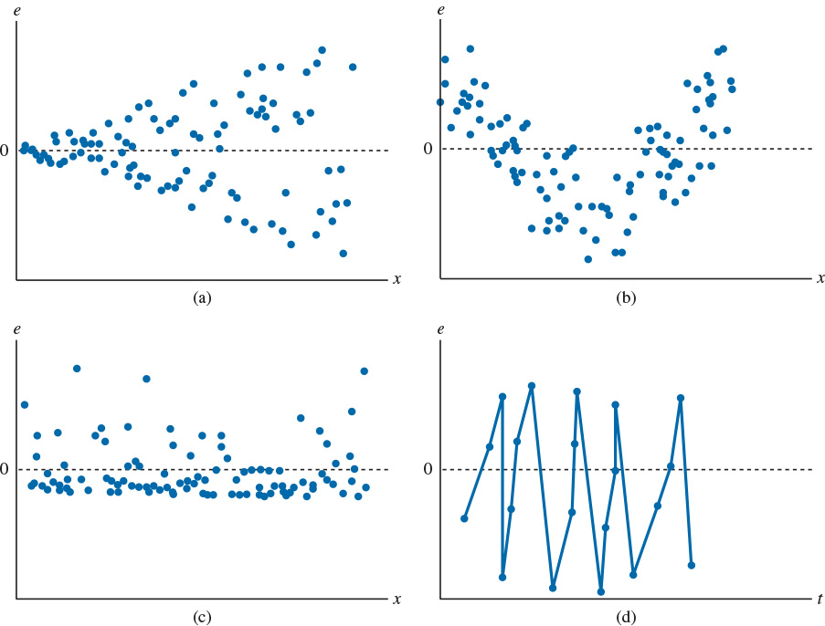
8.5 Common Error Term Violations
Non-constant spread
Non-normal residuals
Nonlinear pattern
Non-independent residuals

Slide 30
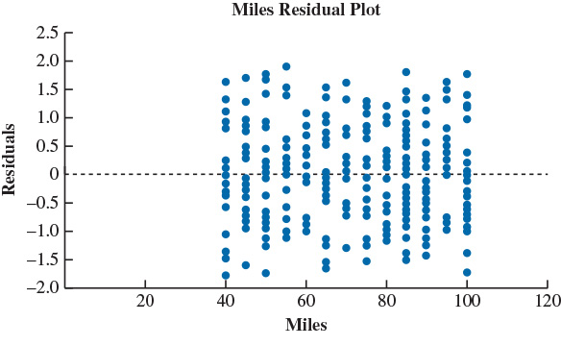
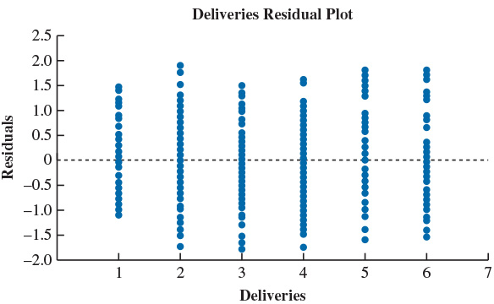
8.5 Excel Residual Plots for the Butler Trucking Co.
Residuals vs. Miles
Residuals vs. Deliveries
Both Residual plots show valid conditions for inference. In Excel, select the Residual Plots option in the Residuals area of the Regression dialog box.

Slide 31
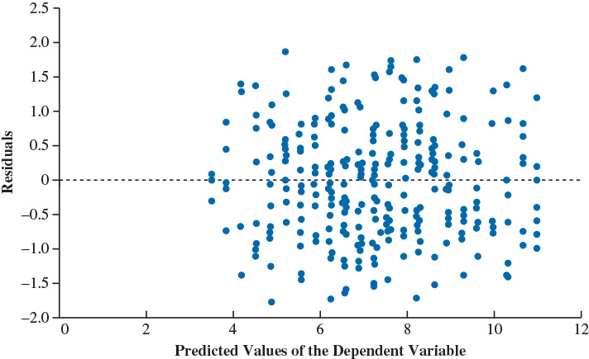
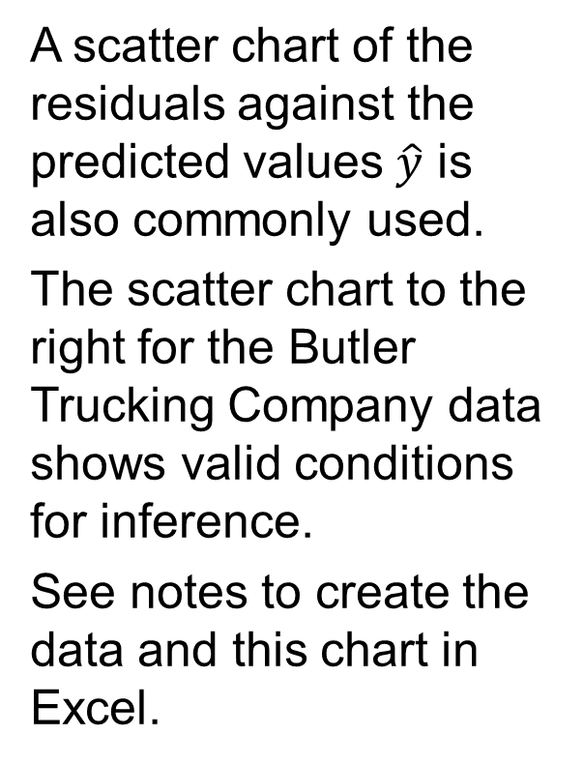
8.5 Scatter Chart of Residuals vs. Predicted Variable
A scatter chart of the residuals against the predicted values $\hat{y}$ is also commonly used.
The scatter chart to the right for the Butler Trucking Company data shows valid conditions for inference.
See notes to create the data and this chart in Excel.
Notes:
To obtain the data to construct a scatter chart of the residuals against the predicted values of the dependent variable using Excel’s Regression tool:
Select the Residuals option in the Residuals area of the Regression dialog box.
This generates a table of predicted values of the dependent variable and residuals for the observations in the data.
We can then use the Excel chart tool to create a scatter chart of these predicted values and residuals.

Slide 32
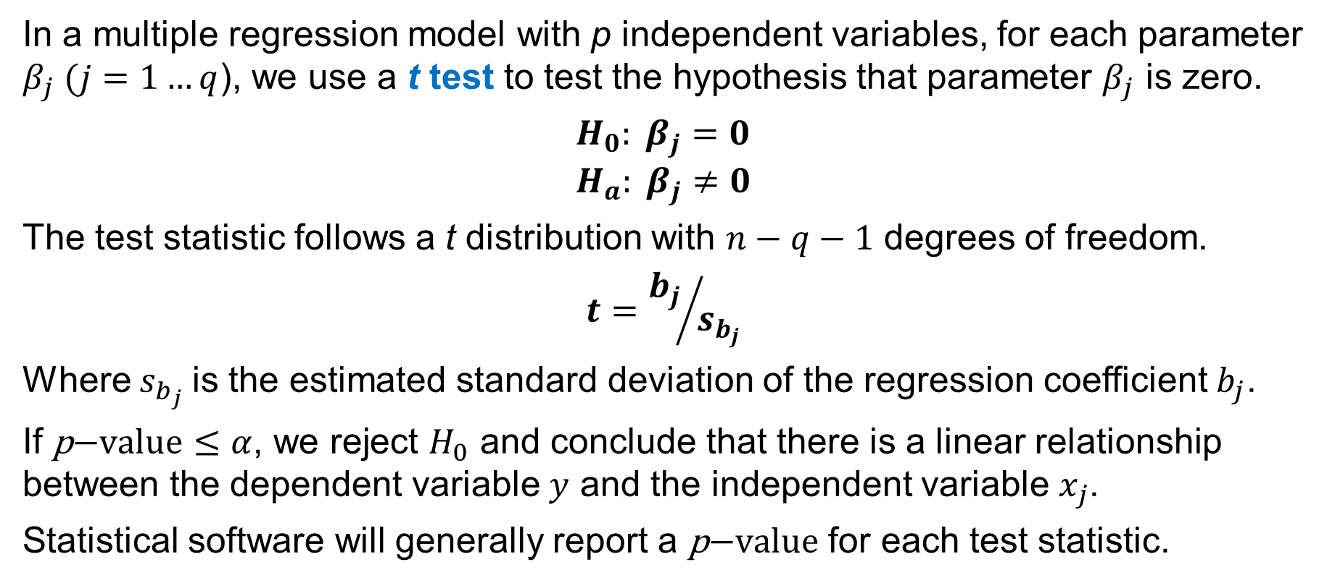
8.5 t Test for Individual Significance
In a multiple regression model with p independent variables, for each parameter $β_{j} (j=1…q$), we use a t test to test the hypothesis that parameter $β_{j}$ is zero.
$H_{0}: β_{j}=0$
$$H_{a}: β_{j}≠0$$
The test statistic follows a t distribution with $n−q−1$ degrees of freedom.
$$t={b_{j}}/{s_{b_{j}}}$$
Where $s_{b_{j}}$is the estimated standard deviation of the regression coefficient $b_{j}$.
If $\text{p}\text{−}\text{value}≤α$, we reject $H_{0}$ and conclude that there is a linear relationship between the dependent variable $y$ and the independent variable $x_{j}$.
Statistical software will generally report a $\text{p}\text{−}\text{value}$ for each test statistic.

Slide 33
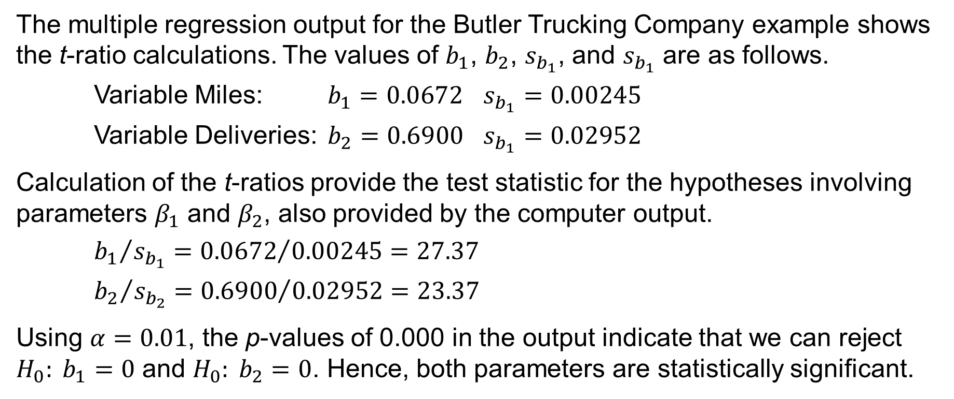
8.5 Individual t Tests for the Butler Trucking Co. Example
The multiple regression output for the Butler Trucking Company example shows the t-ratio calculations. The values of $b_{1}$, $b_{2}$, $s_{b_{1}}$, and $s_{b_{1}}$ are as follows.
Variable Miles: $b_{1}=0.0672$ $s_{b_{1}}=0.00245$
Variable Deliveries: $b_{2}=0.6900$ $s_{b_{1}}=0.02952$
Calculation of the t-ratios provide the test statistic for the hypotheses involving parameters $β_{1}$ and $β_{2}$, also provided by the computer output.
${b_{1}}/{s_{b_{1}}}={0.0672}/{0.00245}=27.37$
${b_{2}}/{s_{b_{2}}}={0.6900}/{0.02952}=23.37$
Using $α=0.01$, the p-values of 0.000 in the output indicate that we can reject $H_{0}: b_{1}=0$ and $H_{0}: b_{2}=0$. Hence, both parameters are statistically significant.

Slide 34
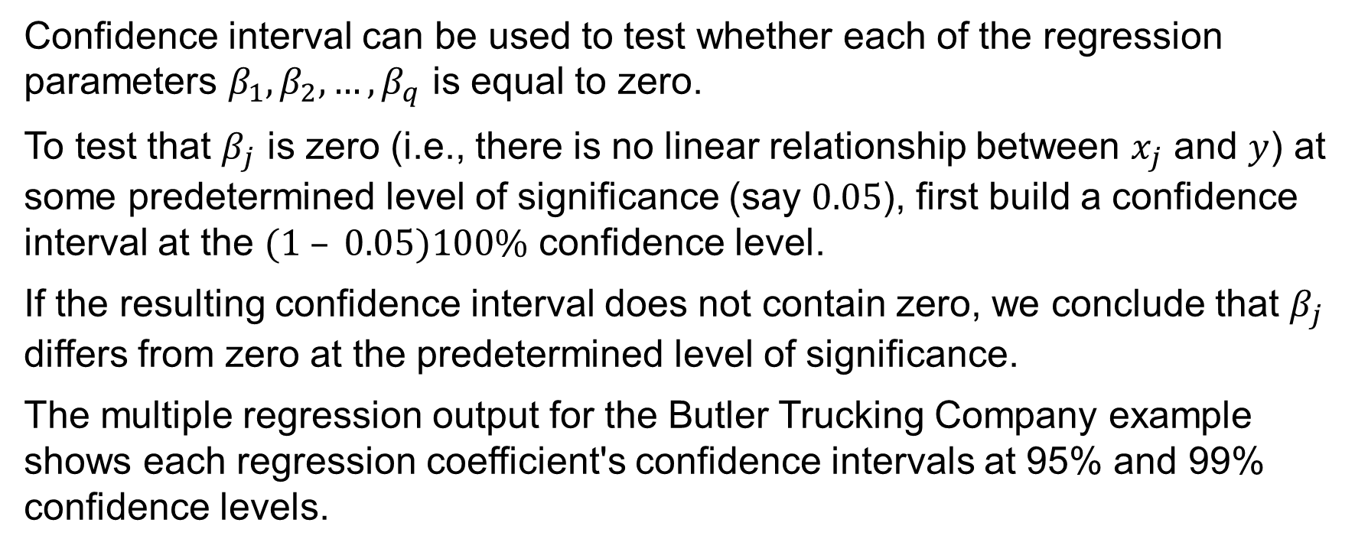
8.5 Testing Regression Coefficients with Confidence Intervals
Confidence interval can be used to test whether each of the regression parameters $β_{1},β_{2},…,β_{q}$ is equal to zero.
To test that $β_{j}$ is zero (i.e., there is no linear relationship between $x_{j}$ and $y$) at some predetermined level of significance (say $0.05$), first build a confidence interval at the $(1 – 0.05)100\%$ confidence level.
If the resulting confidence interval does not contain zero, we conclude that $β_{j}$ differs from zero at the predetermined level of significance.
The multiple regression output for the Butler Trucking Company example shows each regression coefficient's confidence intervals at 95% and 99% confidence levels.

Slide 35
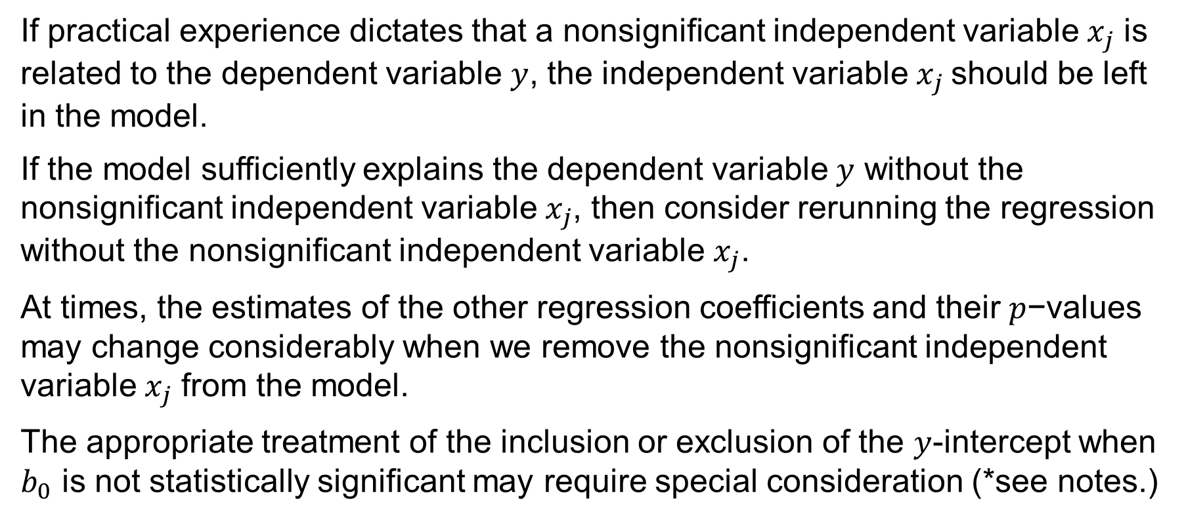
8.5 Addressing Nonsignificant Independent Variables
If practical experience dictates that a nonsignificant independent variable $x_{j}$ is related to the dependent variable $y$, the independent variable $x_{j}$should be left in the model.
If the model sufficiently explains the dependent variable $y$ without the nonsignificant independent variable $x_{j}$, then consider rerunning the regression without the nonsignificant independent variable $x_{j}$.
At times, the estimates of the other regression coefficients and their $p$−values may change considerably when we remove the nonsignificant independent variable $x_{j}$ from the model.
The appropriate treatment of the inclusion or exclusion of the $y$-intercept when $b_{0}$ is not statistically significant may require special consideration (*see notes.)
Notes:
*Since the primary purpose of the regression model is to explain or predict values of the dependent variable for values of the independent variables that lie within the experimental region on which the model is based, regression through the origin should not be forced unless there are strong a priori reasons for believing that the dependent variable is equal to zero when the values of all independent variables in the model are equal to zero.

Slide 36
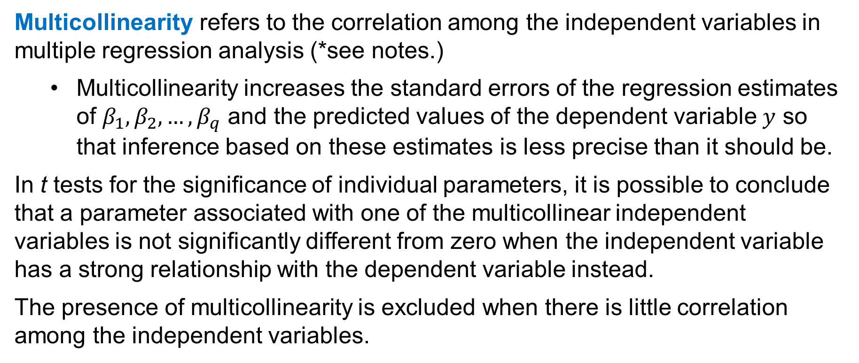
8.5 Multicollinearity
Multicollinearity refers to the correlation among the independent variables in multiple regression analysis (*see notes.)
Multicollinearity increases the standard errors of the regression estimates of $β_{1},β_{2},…,β_{q}$ and the predicted values of the dependent variable $y$ so that inference based on these estimates is less precise than it should be.
In t tests for the significance of individual parameters, it is possible to conclude that a parameter associated with one of the multicollinear independent variables is not significantly different from zero when the independent variable has a strong relationship with the dependent variable instead.
The presence of multicollinearity is excluded when there is little correlation among the independent variables.
Notes:
*According to a common rule of thumb test, multicollinearity is a potential problem if the absolute value of the sample correlation coefficient exceeds 0.7 for any two of the independent variables.
Multicollinearity does not affect the predictive capability of a linear regression model, so if the primary objective is prediction or forecasting, then multicollinearity is not a concern.

Slide 37
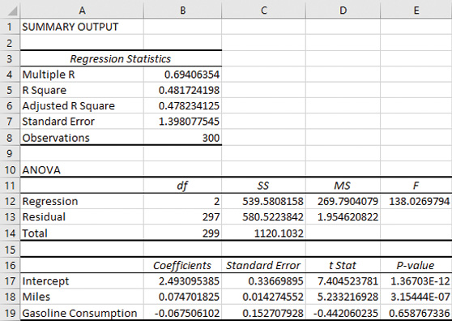
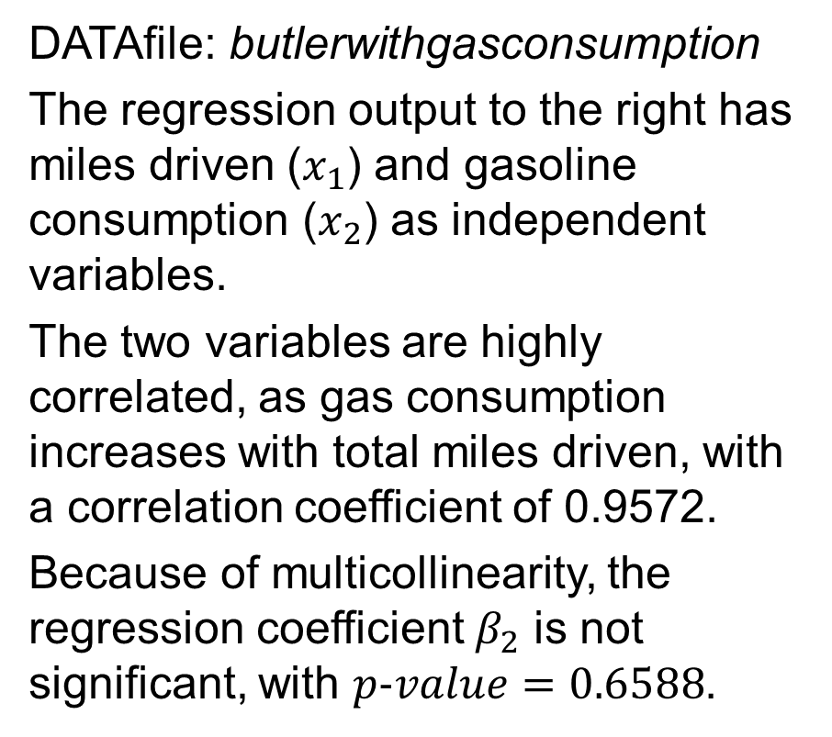
8.5 Multicollinearity in the Butler Trucking Co. Data
DATAfile: butlerwithgasconsumption
The regression output to the right has miles driven ($x_{1}$) and gasoline consumption ($x_{2}$) as independent variables.
The two variables are highly correlated, as gas consumption increases with total miles driven, with a correlation coefficient of 0.9572.
Because of multicollinearity, the regression coefficient $β_{2}$ is not significant, with $p\text{−}value=0.6588$.

Slide 38
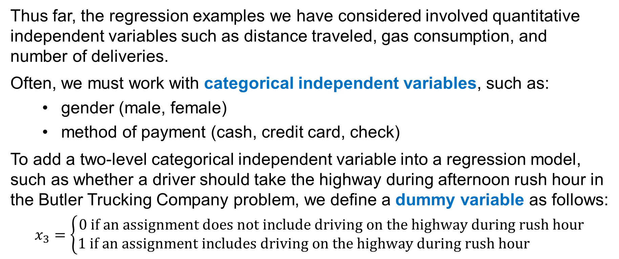
8.6 Dummy Variables
Thus far, the regression examples we have considered involved quantitative independent variables such as distance traveled, gas consumption, and number of deliveries.
Often, we must work with categorical independent variables, such as:
gender (male, female)
method of payment (cash, credit card, check)
To add a two-level categorical independent variable into a regression model, such as whether a driver should take the highway during afternoon rush hour in the Butler Trucking Company problem, we define a dummy variable as follows:
$$x_{3}=\left\{\begin{aligned}0 \text{if} \text{an} \text{assignment} \text{does} \text{not} \text{include} \text{driving} \text{on} \text{the} \text{highway} \text{during} \text{rush} \text{hour} \\ 1 \text{if} \text{an} \text{assignment} \text{includes} \text{driving} \text{on} \text{the} \text{highway} \text{during} \text{rush} \text{hour} \end{aligned}\right.$$

Slide 39
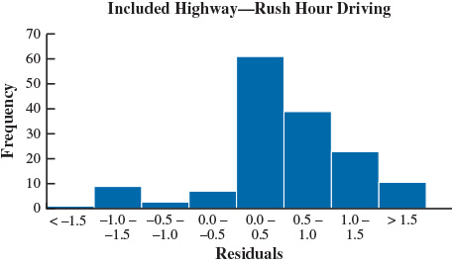
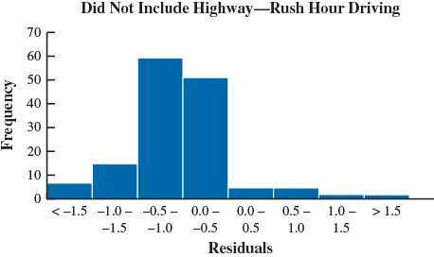
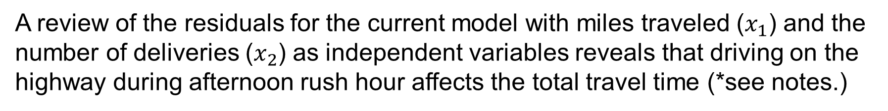
8.6 Effect of Afternoon Rush Hour on Travel Time
A review of the residuals for the current model with miles traveled ($x_{1}$) and the number of deliveries ($x_{2}$) as independent variables reveals that driving on the highway during afternoon rush hour affects the total travel time (*see notes.)
Notes:
*We know that the residual for the ith observation is e_{i} = y_{i} - ${\hat{y}}_{i}$, which is the difference between the observed and predicted values of the dependent variable.
The histograms show that driving assignments that included travel on a congested segment of a highway during the afternoon rush hour period tend to have positive residuals, which means we are generally underpredicting the travel times for those driving assignments.
Conversely, driving assignments that did not include travel on a congested segment of a highway during the afternoon rush hour period tend to have negative residuals, which means we are generally overpredicting the travel times for those driving assignments.
These results suggest that the dummy variable could potentially explain a substantial proportion of the variance in travel time that is unexplained by the current model, and so we proceed by adding the dummy variable x₃ to the current Butler Trucking multiple regression model.

Slide 40
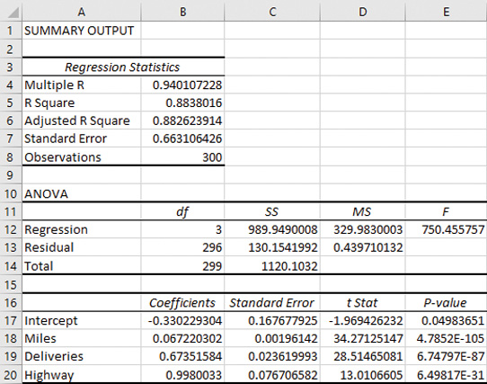
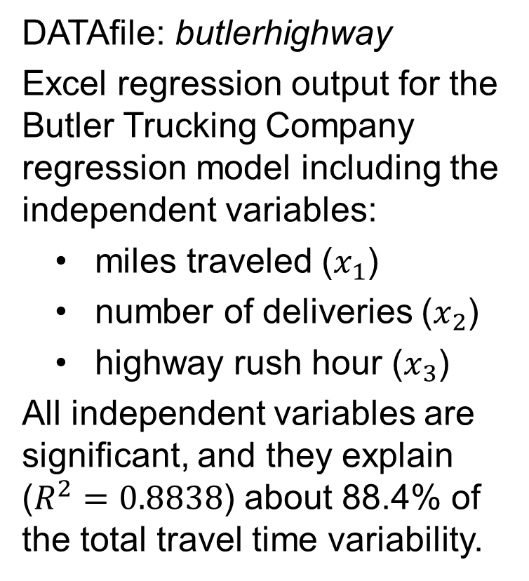
8.6 Regression Output with Highway Rush Hour Variable
DATAfile: butlerhighway
Excel regression output for the Butler Trucking Company regression model including the independent variables:
miles traveled ($x_{1}$)
number of deliveries ($x_{2}$)
highway rush hour ($x_{3}$)
All independent variables are significant, and they explain ($R^{2}=0.8838$) about 88.4% of the total travel time variability.

Slide 41
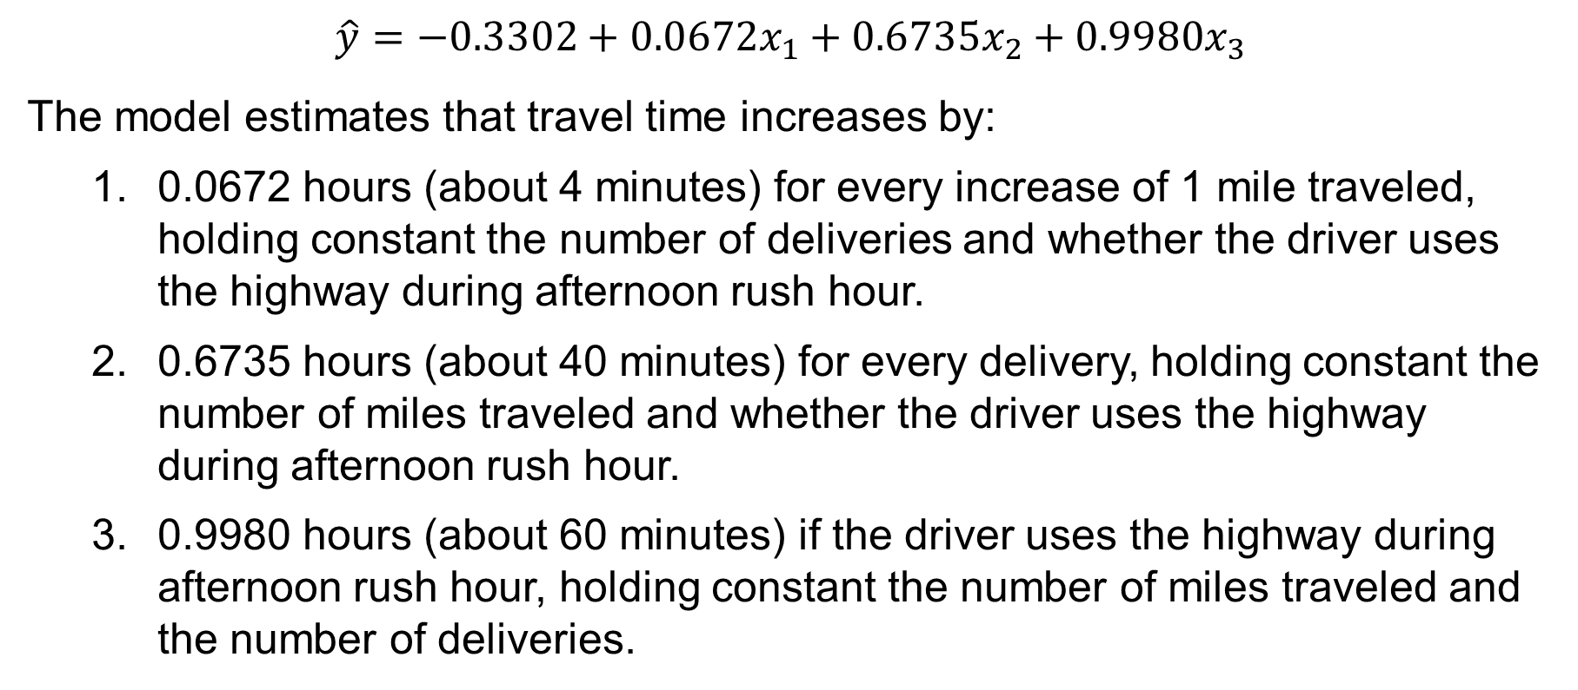
8.6 Interpreting the Parameters for the Butler Example
$\hat{y}=−0.3302+0.0672x_{1}+0.6735x_{2}+0.9980x_{3}$
The model estimates that travel time increases by:
0.0672 hours (about 4 minutes) for every increase of 1 mile traveled, holding constant the number of deliveries and whether the driver uses the highway during afternoon rush hour.
0.6735 hours (about 40 minutes) for every delivery, holding constant the number of miles traveled and whether the driver uses the highway during afternoon rush hour.
0.9980 hours (about 60 minutes) if the driver uses the highway during afternoon rush hour, holding constant the number of miles traveled and the number of deliveries.

Slide 42
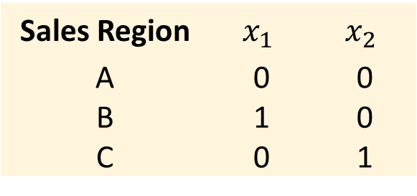
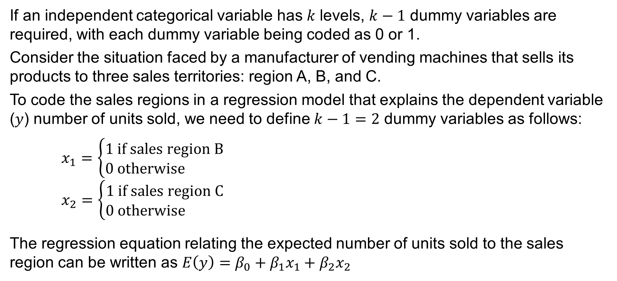
8.6 More Complex Categorical Variables
If an independent categorical variable has 𝑘 levels, $k−1$ dummy variables are required, with each dummy variable being coded as 0 or 1.
Consider the situation faced by a manufacturer of vending machines that sells its products to three sales territories: region A, B, and C.
To code the sales regions in a regression model that explains the dependent variable (𝑦) number of units sold, we need to define $k−1=2$ dummy variables as follows:
$x_{1}=\left\{\begin{aligned}1 \text{if} \text{sales} \text{region} \text{B} \\ 0 \text{otherwise} \end{aligned}\right.$
$x_{2}=\left\{\begin{aligned}1 \text{if} \text{sales} \text{region} \text{C} \\ 0 \text{otherwise} \end{aligned}\right.$
The regression equation relating the expected number of units sold to the sales region can be written as $E\left(y\right)=β_{0}+β_{1}x_{1}+β_{2}x_{2}$
Sales Region | $$x_{1}$$ | $$x_{2}$$
A | 0 | 0
B | 1 | 0
C | 0 | 1

Slide 43
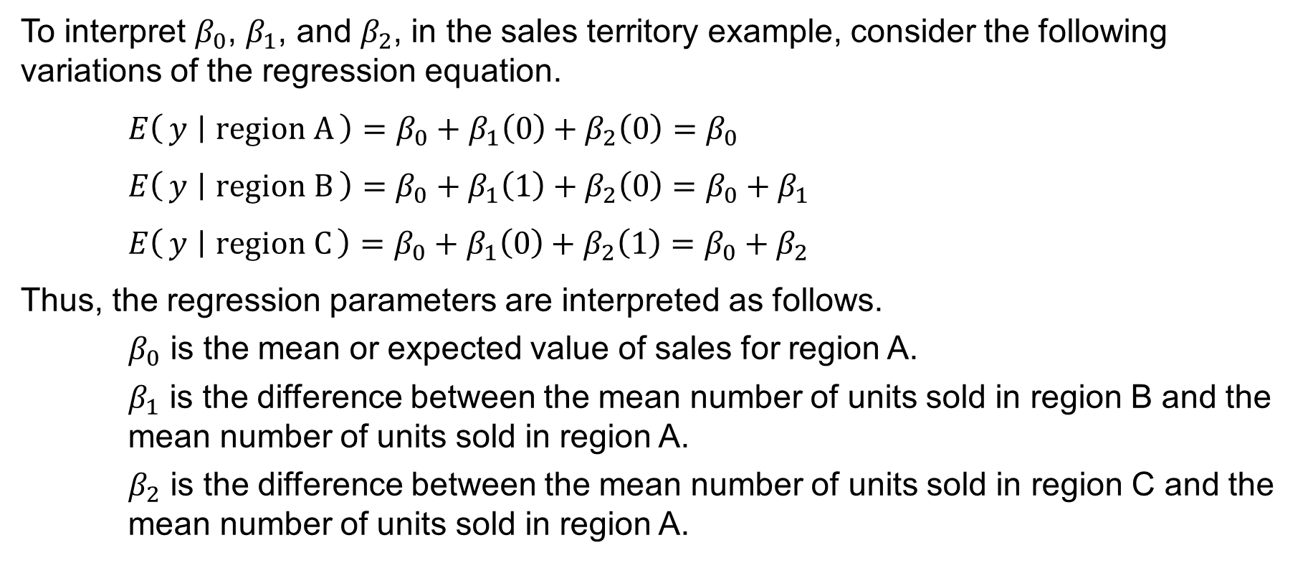
8.6 Interpretation of the Parameters for a Categorical Variable with Three Levels
To interpret $β_{0}$, $β_{1}$, and $β_{2}$, in the sales territory example, consider the following variations of the regression equation.
$E\left(y ∣ \text{region} \text{A}\right)=β_{0}+β_{1}\left(0\right)+β_{2}\left(0\right)=β_{0}$
$E\left(y ∣ \text{region} \text{B}\right)=β_{0}+β_{1}\left(1\right)+β_{2}\left(0\right)=β_{0}+β_{1}$
$E\left(y ∣ \text{region} \text{C}\right)=β_{0}+β_{1}\left(0\right)+β_{2}\left(1\right)=β_{0}+β_{2}$
Thus, the regression parameters are interpreted as follows.
$β_{0}$ is the mean or expected value of sales for region A.
$β_{1}$ is the difference between the mean number of units sold in region B and the mean number of units sold in region A.
$β_{2}$ is the difference between the mean number of units sold in region C and the mean number of units sold in region A.

Slide 44



8.7 Modeling Nonlinear Relationships
A Manager at Reynolds, Inc., a manufacturer of industrial scales, wants to investigate the relationship between length of employment ($x$) and the number of electronic laboratory scales sold ($y$) for a sample of 123 salespeople.
DATAfile: reynolds
The estimated linear regression equation is
$Sales=183.291+2.358 Months$
The scatter diagram indicates a curvilinear relationship between the length of time employed and the number of units sold.

Slide 45

8.7 A Curvilinear Pattern in the Reynolds Data
The pattern in the scatter chart of residuals against the predicted values of the dependent variable suggests that a curvilinear relationship may provide a better fit to the data.
We may wish to consider an alternative to simple linear regression if we have a practical reason to suspect a curvilinear relationship.
For example, a salesperson who has been employed for a long time may eventually become burned out and less efficient.

Slide 46


8.7 A Quadratic Regression Model
To account for the curvilinear relationship, we add an independent variable, MonthSq, as the square of the number of months the salesperson has been with the firm. See notes for Excel.
The following equation describes a quadratic regression model.
$\hat{y}=b_{0}+b_{1}x+b_{2}x^{2}$
The regression output produces the estimated quadratic regression equation for the Reynolds problem:
$Sales=101.985+6.136 Months$
$$−0.0341 MonthSq$$
Notes:
To create a quadratic regression model for the reynolds data in Excel, follow these steps.
Step 1. Move the Scales Sold heading and values from column B to column C by cutting (Ctrl-X) cell range B1:B124 and pasting it (Ctrl-V) to cell range C1:C124.
Step 2. In Cell B1, type “MonthSq”
In Cell B2, type “=A2^2”
Copy cell B2 and paste it cell range B3:B124
Step 3. Perform a multiple regression using the Data Analysis regression tool with Input Y Range: C1:C124 and Input X Range: A1:B124, as previously shown.
Check the Labels box
Click OK.

Slide 47

8.7 Interpreting a Quadratic Regression Equation
If the estimated parameters $b_{1}$ and $b_{2}$ corresponding to the linear term $x$ and the squared term $x^{2}$ have the same sign, the estimated dependent variable $\hat{y}$ is
increasing over the experimental range of $x$ when $b_{1}>0$ and $b_{2}>0$ or
decreasing over the experimental range of $x$ when $b_{1}<0$ and $b_{2}<0$.
If, on the other hand, the estimated parameters $b_{1}$ and $b_{2}$ corresponding to the linear term $x$ and the squared term $x^{2}$ have different signs, $\hat{y}$ has
a maximum over the experimental range of $x$ when $b_{1}>0$ and $b_{2}<0$ or
a minimum over the experimental range of $x$ when $b_{1}<0$ and $b_{2}>0$ .
In the case of the Reynolds data, we can use calculus to demonstrate that the maximum sales occur at $x=90$.
Thus, maximum sales are: $Sales=101.985+6.136 \left(90\right)−0.0341\left({90}^{2}\right)=378$

Slide 48

8.7 Types of Quadratic Regression Models

Slide 49

8.7 Interaction Between Independent Variables
An interaction is a relationship between the dependent variable and one independent variable that is different at various values of a second independent variable.
If the original data set consists of observations for $y$ and two independent variables $x_{1}$ and $x_{2}$, we can incorporate an $x_{1}x_{2}$ interaction term into the estimated multiple linear regression equation in the following manner.
$\hat{y}=b_{0}+b_{1}x_{1}+b_{2}x_{2}+b_{3}x_{1}x_{2}$
When an interaction term between two variables is present, we cannot study the relationship between one independent variable and the dependent variable $y$ independently of the other variable.
See notes and next slide for an Excel application that uses the DATAFile: tyler.
Notes:
To create a regression model with interaction term for the tyler data in Excel, follow these steps.
Step 1. Move the Sales(1000s) heading and values from column C to column D by cutting (Ctrl-X) cell range C1:C25 and pasting it (Ctrl-V) to cell range D1:D25.
Step 2. In Cell C1, type “Price*Advertising”
Step 3. In Cell C2, type “=A2*B2”
Step 4. Copy cell C2 and paste it cell range C3:C25
Step 5. Perform a multiple regression using the Data Analysis regression tool with Input Y Range: D1:D25 and Input X Range: A1:C25, as previously shown
Check the Labels box
In the Output Options section, check the radio button Output Range and type or select cell F1
Click OK.

Slide 50

8.7 Regression Output for the Tyler Personal Care Example
Notes:
To create a regression model with interaction term for the tyler data in Excel, follow these steps.
Step 1. Move the Sales(1000s) heading and values from column C to column D by cutting (Ctrl-X) cell range C1:C25 and pasting it (Ctrl-V) to cell range D1:D25.
Step 2. In Cell C1, type “Price*Advertising”
In Cell C2, type “=A2*B2”
Copy cell C2 and paste it cell range C3:C25
Step 3. Perform a multiple regression using the Data Analysis regression tool with Input Y Range: D1:D25 and Input X Range: A1:C25, as previously shown
Check the Labels box
In the Output Options section, check the radio button Output Range and type or select cell F1
Click OK.

Slide 51

8.7 Piecewise Linear Regression Model
A piecewise linear regression model is a type of interaction with a dummy variable that allows fitting nonlinear relationships as two linear regressions joined at the value of $x$ at which the relationship between $x$ and $y$ changes.
The value of the independent variable, $x^{\left(k\right)}$, at which the relationship between $x$ and $y$ changes is called a knot, or breakpoint.
A dummy variable $x_{k}$ is added to the model such that
$x_{k}=\left\{\begin{aligned}0 \text{if} x_{k}≤x^{\left(k\right)} \\ 1 \text{if} x_{k}>x^{\left(k\right)}\end{aligned}\right.$
Then, the following estimated regression equation is fit:
$\hat{y}=b_{0}+b_{1}x_{1}+b_{2}\left(x_{1}−x^{\left(k\right)}\right)x_{k}$

Slide 52


8.7 Piecewise Linear Regression Model for Reynolds Data
We observe that below some value of Months Employed, the relationship with Sales appears to be positive and linear. Whereas the relationship becomes negative and linear for the remaining observations. See notes for Excel.
As shown in the previous slide, we add a dummy variable to the model with knot at $x^{\left(k\right)}=70$.
The regression output, shown in the next slide, produces the following estimated regression equation, with all independent variables significant:
$\hat{y}=147.46+3.354x_{1}−3.661\left(x_{1}−70\right)x_{k}$
Notes:
To create a piecewise linear regression model for the reynolds data in Excel using $x^{\left(k\right)}=70$, follow these steps.
Step 1. Move the Scales Sold heading and values from column B to column D by cutting (Ctrl-X) cell range B1:B124 and pasting it (Ctrl-V) to cell range D1:D124.
Step 2. Move the Months Employed heading and values from column A to column B by cutting (Ctrl-X) cell range A1:A124 and pasting it (Ctrl-V) to cell range B1:B124.
Step 3. In Cell A1, type “Knot”
In Cell A2, type “=IF(B2<=70,0,1)”
Copy cell A2 and paste it cell range A3:A124
Step 4. In Cell C1, type “Knot Dummy*(Months-70)”
In Cell C2, type “=A2*B2”
Copy cell C2 and paste it cell range C3:C124
Step 5. Perform a multiple regression using the Data Analysis regression tool with Input Y Range: D1:D124 and Input X Range: B1:C124, as previously shown.
Check the Labels box
In the Output Options section, check the radio button Output Range and type or select cell F1
Click OK.

Slide 53

8.7 Piecewise Regression Output for Reynolds Data

Slide 54
8.8 Variable Selection Procedures
There are four major variable selection procedures we can use to find the best estimated regression equation for a set of independent variables (*see notes):
Stepwise Regression
Forward Selection
Backward Elimination
Best-Subsets Regression
The first three procedures are Iterative; one independent variable at a time is added or deleted but offers no guarantee that the best model will be found.
In the fourth procedure, all possible subsets of the independent variables are evaluated.
Notes:
The Backward elimination procedure begins with the regression model that includes all of the independent variables under consideration.
At each step, backward elimination considers the removal of an independent variable according to some criterion.
Stops when all independent variables in the model are significant at a specified level of significance.
The Forward selection procedure begins with none of the independent variables under consideration included in the regression model.
At each step, forward selection considers the addition of an independent variable according to some criterion.
Stops when there are no independent variables not currently in the model that meet the criterion for being added to the regression model.
The Stepwise selection procedure begins with none of the independent variables under consideration included in the regression model.
The analyst establishes a criterion for allowing independent variables to enter the model and a criterion for allowing independent variables to remain in the model.
To initiate the procedure, the most significant independent variable is added to the empty model if its level of significance satisfies the entering threshold.
Each subsequent step involves two intermediate steps:
First, the remaining independent variables not in the current model are evaluated, and the most significant one is added to the model.
Then the independent variables in the current model are evaluated, and the least significant one is removed.
Stops when no independent variables not currently in the model have a level of significance for remaining in the regression model.
The Best subsets procedure builds simple linear regressions for each of the independent variables under consideration generated, and then the multiple regressions with all combinations of two independent variables under consideration are generated, and so on.
Once a regression model has been generated for every possible subset of the independent variables under consideration, the entire collection of regression models can be compared and evaluated.

Slide 55
8.8 Overfitting
Overfitting generally results from creating an overly complex regression model to explain idiosyncrasies in the sample data.
An overfit model will overperform on the sample data used to fit the model and underperform on other data from the population.
To avoid overfitting a model:
Use only real and meaningful independent variables.
Only use complex models when you have reasonable expectations about them.
Use variable selection procedures only for guidance.
If you have sufficient data, consider cross-validation, in which you assess the model on data other than the sample data used to generate the model.
One example of cross-validation is the holdout method, which divides the data set between a training set and a validation set.

Slide 56


8.9 Inference and Very Large Samples
Virtually all regression coefficients will be statistically significant if the sample is sufficiently large.
DATAfile: largecredit
The regression output to the right shows a modest $R^{2}$ for a data set with $n=3,000$.
All the regression coefficients are significant.
See notes for details.
Notes:
The model has a coefficient of determination of 0.3645 (see cell B5), indicating that this model explains approximately 36% of the variation in credit card charges accrued by the customers in the sample over the past year.
The p-value for each test of the individual regression parameters is also very small (see cells E18 through E21), indicating that for each independent variable, we can reject the hypothesis of no relationship with the dependent variable.
The estimated slopes associated with the dependent variables are all highly significant. The model estimates the following:
For a fixed number of household members, number of years of post-high school education, and hours per week watching TV, accrued credit card charges increase by $121.61 when a customer’s annual household income increases by $1,000 (cell B18.)
For a fixed annual household income, number of years of post-high school education, and hours per week watching TV, accrued credit card charges increase by $531.21 when a customer’s household increases by one member (cell B19.)
For a fixed annual household income, number of household members, and hours per week watching TV, accrued credit card charges decrease by $539.83 when a customer’s number of years of post-high school education increases by one year (cell B20.)
For a fixed annual household income, number of household members, and number of years of post-high school education, accrued credit card charges increase by $12.55 when a customer’s hours per week watching TV increases by one hour (cell B21.)

Slide 57

8.9 Model Selection
When dealing with large samples, it is often difficult to discern the most appropriate model.
If developing a regression model for explanatory purposes, the practical significance of the estimated regression coefficients should be considered when interpreting the model and considering which variables to keep.
If developing a regression model to make future predictions, selecting the independent variables to include in the model should be based on the predictive accuracy of observations that have not been used to train it.
For example, the credit card data set could be split into two data sets:
a training data set with $n=2,000$, and
a validation data set with $n=1,000$.

Slide 58

8.10 Prediction with Linear Regression
In addition to the point estimate, there are two types of interval estimates associated with the regression equation:
A confidence interval is an interval estimate of the mean $y$ value given values of the independent variables $x_{1},x_{2},…,x_{q}$.
$$\hat{y}±t_{α/2}s_{\hat{y}} \text{where} s_{\hat{y}} \text{is} \text{the} \text{estimated} \text{standard} \text{deviation} \text{of} \hat{y}$$
A prediction interval is an interval estimate of an individual $y$ value given values of the independent variables $x_{1},x_{2},…,x_{q}$.
$$\hat{y}±t_{α/2}\sqrt{s_{\hat{y}}^{2}+{SSE}/{\left(n−p−1\right)}} \text{where} s_{\hat{y}}^{2} \text{is} \text{the} \text{estimated} \text{variance} \text{of} \hat{y}$$
The calculation of the confidence and prediction intervals use matrix algebra and requires the use of specialized statistical software.

Slide 59
8.10 Prediction of New Routes for Butler Trucking Co.
Predicted Values and 95% Confidence Intervals and Prediction Intervals for 10 New Butler Trucking Routes (DATAfile: butler)
Assignment | Miles | Deliveries | Predicted Value | 95% Cl Half-Width(+/−) | 95% PI Half-Width(+/−)
301 | 105 | 3 | 9.25 | 0.193 | 1.645
302 | 60 | 4 | 6.92 | 0.112 | 1.637
303 | 95 | 5 | 9.96 | 0.173 | 1.642
304 | 100 | 1 | 7.54 | 0.225 | 1.649
305 | 40 | 3 | 4.88 | 0.177 | 1.643
306 | 80 | 3 | 7.57 | 0.108 | 1.637
307 | 65 | 4 | 7.25 | 0.103 | 1.637
308 | 55 | 3 | 5.89 | 0.124 | 1.638
309 | 95 | 2 | 7.89 | 0.175 | 1.643
310 | 95 | 3 | 8.58 | 0.154 | 1.641

Slide 60

Summary
In this chapter, we showed how linear regression analysis is used to determine how a dependent variable $y$ is related to one or more independent variables.
We used sample data and the least squares method to develop the estimated simple linear regression equation, interpreted its coefficients, and presented the coefficient of determination as a measure of its goodness of fit.
We then extended our discussion to include multiple independent variables and reviewed how to use Excel to find the estimated multiple linear regression equation, build estimates in the form of prediction and confidence intervals, and the ramifications of multicollinearity.
We discussed the necessary conditions for the linear regression model and its associated error term to conduct valid inference for regression.
We showed how to incorporate categorical independent variables into a regression model and discussed how to fit nonlinear relationships.
Finally, we discussed various variable selection procedures, the problem of overfitting, and the implication of big data on regression analysis.

